Slide 1
Bayside City Council
Financial Positon and Future Challenges

Slide 2
2015/16 Results
Operating Surplus
Operating surplus of $26.75M
Surplus used to fund debt reduction and Capital works expenditure
Notes:
. The favourable variance is due mainly to:
$4.0M Resort and recreation levy income was favourable to budget reflecting an increase in building development. These funds are quarantined in a statutory reserve to be made available for future open space enhancement.
$582k operating grants received in advance predominantly for Aged & Disability programs to be delivered in 2016/17.
$598k carbon tax rebate for carbon tax paid in prior years on the waste disposal contract.
$768k parking fines favourable to budget reflecting 43% increase in parking infringements issued due to better weather conditions and an increase in weekend patrols throughout the year
Expenditure was $2.48M favourable to budget as a result of a number of savings initiatives achieved during the year.

Slide 3
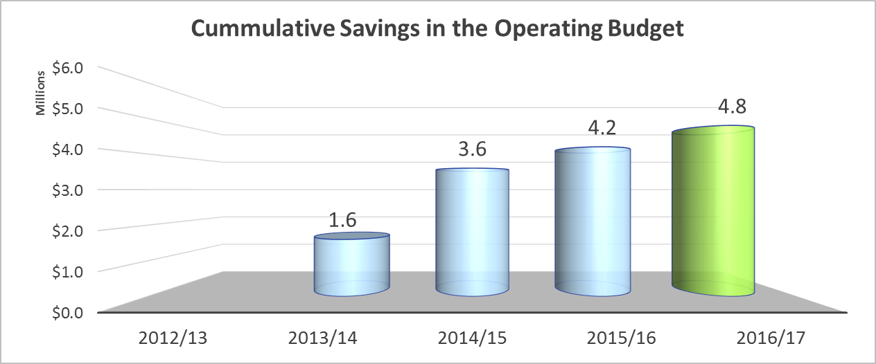
2015/16 Results
Savings in the Operating Services Budget
Cumulative Savings in the Operating Services Budget over the last 3 years $4.2M
Savings identified for 2016/17 $577k (1% of net cost of services)
Capacity to achieve further savings without impacting service delivery diminishing

Slide 4
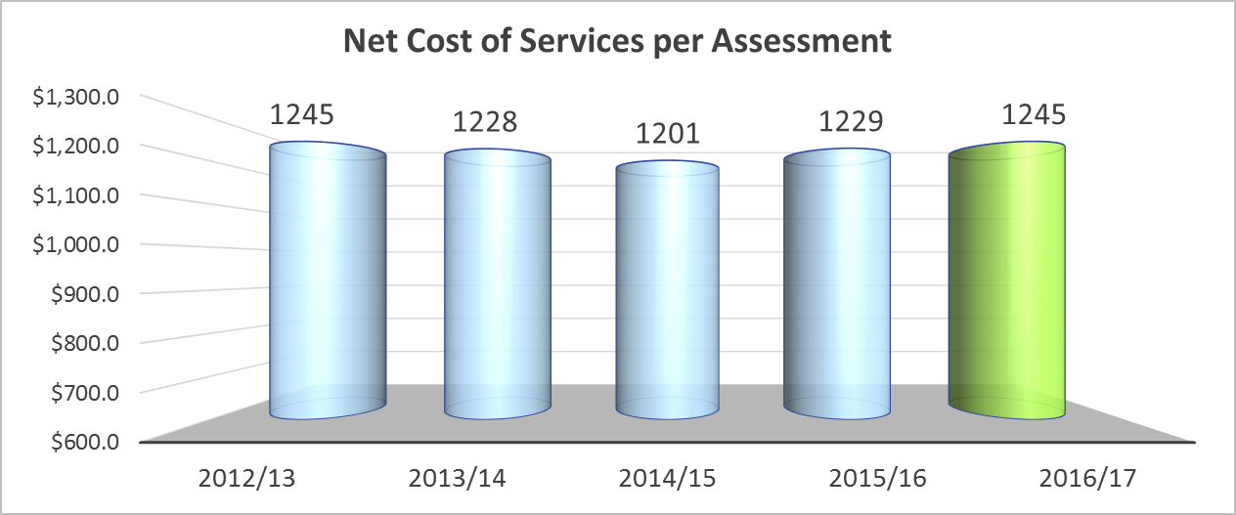
2015/16 Results
Net cost of services
Net cost of services increase 2.4% to $54.6 million in 2016/17
Net cost per assessment increase 1.3% to $1,245 in 2016/17

Slide 5
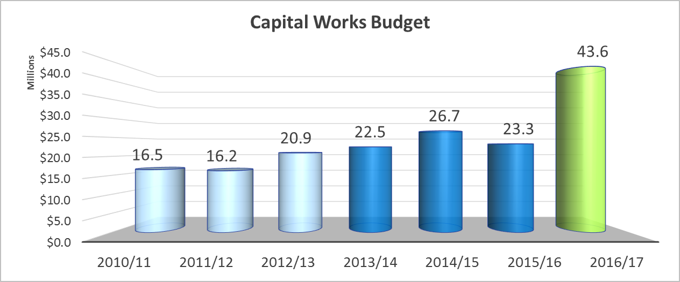
2015/16 Results
Increase in Capital investment
Investment in infrastructure has increased significantly in recent years funded by savings in the operating budget and an increase in external funding

Slide 6
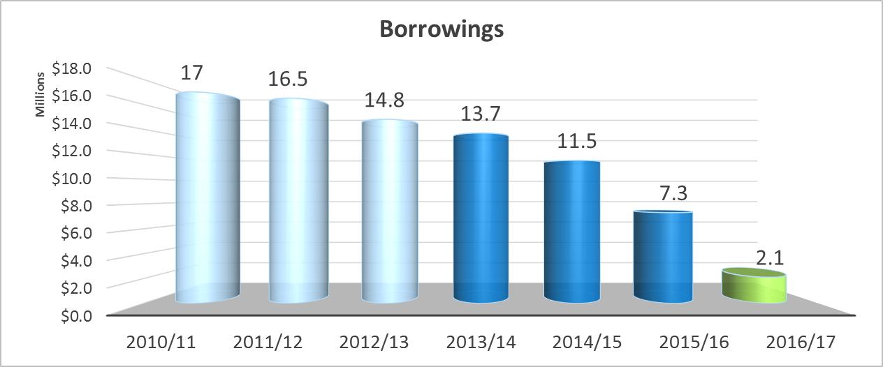
2015/16 Results
Reduction in debt
Council has committed to repaying debt as it matures
Debt free in 2017/18
This provides flexibility for infrastructure investment in the future

Slide 7
Looking ahead - Key financial challenges:
Rate Capping
Managing within a narrow revenue base with limited growth opportunities
Maintaining sufficient funding to renew existing assets and deliver new infrastructure
Continuing to provide an appropriate range and level of services to the community
Managing ongoing cost shifting from other levels of government

Slide 8
The Ongoing Impact of Rate Capping
The Long Term Financial Plan had been based on an annual 4.3% rate Increase
The introduction of rate capping linked to CPI at around 2.5% reduced the amount of rate income by $1.4Mill for 16/17
The cumulative impact of a rate cap at 2.5% is around $75 mill over the 10 year plan
Early indications are that the rate cap for 17/18 will be around 1.75%
Delivering a further reduction in revenue of $576K compounding into the future on top of the $500k in cuts required to make the LTFP work
If CPI remains that low for an extended period the adjustments we need to make to remain sustainable will have to occur earlier than had been anticipated

Slide 9
Strategies to address the challenges
Use our strong cash position to fund capital renewal and new/upgrade works
Accelerated reduction of long term debt held by Council to loan repayment obligations and to create some flexibility for future funding
Strategic reviews of Council services – What services should we deliver and how best to deliver them
Efficiency gains / cuts in the operating budget
Alternative sources of revenue
  fees and charges
  financial returns on property portfolio.
Reductions in capital works beyond Year 4

Slide 10
Financial Impact of Change of Use for Elsternwick Park
Capital Costs
The current 4 Year Indicative Capital Program contains $6.2 million for works at Elsternwick Park
There is some potential for this amount to be increased however, there is competition for available funds

Slide 11
Financial Impact of Change of Use at Elsternwick Park
Operating Budget
Golf Course generates Income of $114,000 per annum for Council
The costs of maintaining the course are met by the contractor.
Should the golf course cease to operate the estimated net impact on Council is around $400k per annum – offsetting reductions in other expenditure areas would have to be found to offset this.
The 17/18 Budget already requires recurrent cuts in the operating budget of just over $1mill – another $400k will not be easily found.

Slide 12
Existing Lease Conditions
The current golf course lease expires in 2018
The leasee has two 5 year options available to exercise at its discretion
The number of rounds played at the course has declined over time
The number of rounds for 2015/16 is 21,200 – not enough to sustain the long term operation of the course without subsidy

