Slide 1
Presentation to Bayside Deliberative Panel about future of Ep north
Sunday 13th November

Slide 2


Slide 3
Focus of this presentation
That active sport and conservation can co-exist together harmoniously
That the youth of Elsternwick, brighton and elwood need a voice in this process that provides options for them in the future
Balancing the needs of all users equitably and Fairly
Integration of uses and balance active and passive sports

Slide 4
Perspectives
Where am I coming from
30 year member of ECC
Educator

Slide 5
What we know
Population Density and Housing density is increasing
Big increases in children in the area. Schools bulging at seams and their active space taken by portable classrooms. Pressure on sporting clubs
Lack of facilities for girls
The elster creek has been extensively mismanaged. Water quality, water velocity, concrete channels all need addressing and wetlands need expansion. Biofilters, raingardens essential
Bayside council has been treading water for many years and consequently we have run down facilities that are unsafe and not fit for purpose
Bayside is lowly ranked across Metro Melbourne in terms of provision of active recreation facilities

Slide 6
In bayside
Been underprovided
No netball complex
No aquatic centre. Port phillip, glen eira, monash, Kingston, stonnington have them
More bayside residents using other lga facilities.
A lack of high quality facilities
Many facilities such as oval 2 have been neglected over long periods of time

Slide 7
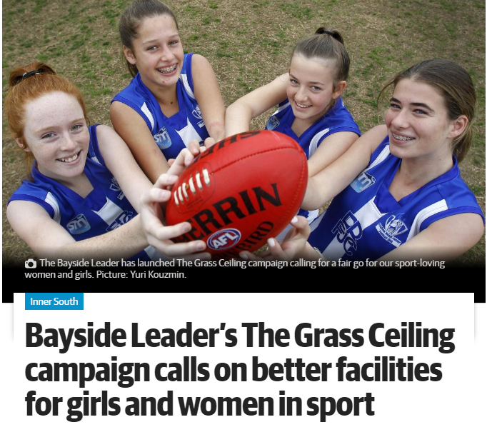

Slide 8
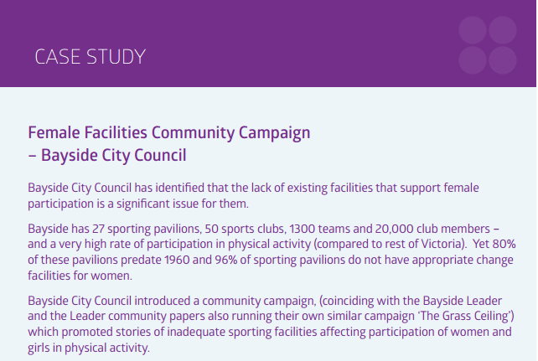

Slide 9
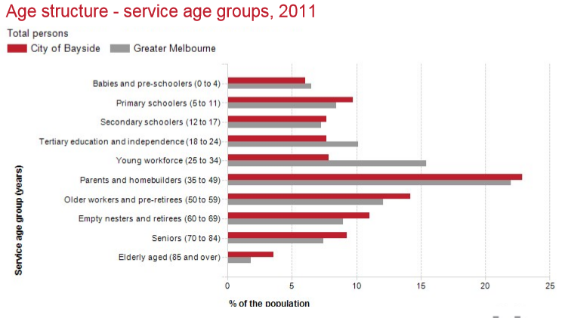

Slide 10
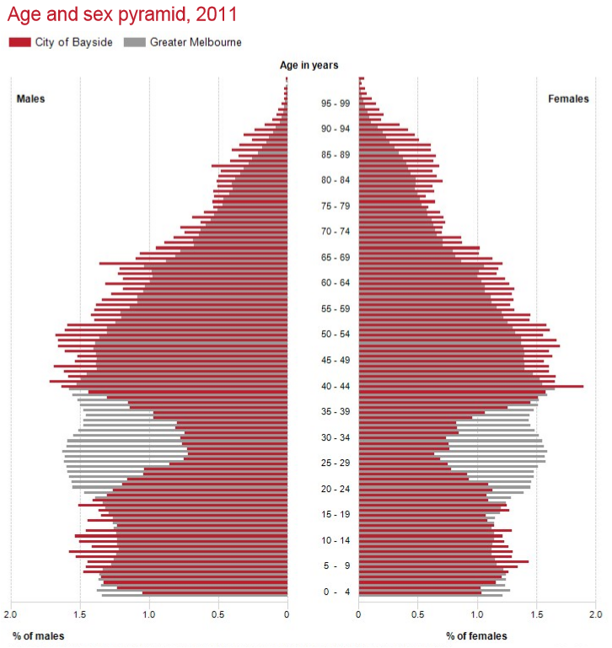

Slide 11
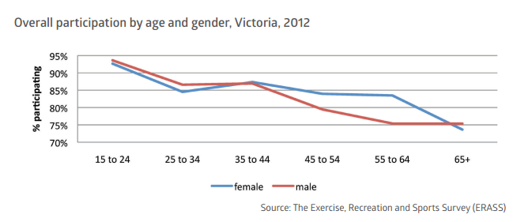
Participation in active sport by age and gender in Victoria in 2012

Slide 12
Calculating FACILITIES PROVISION
The following must be considered:
Participation rates in LGA (Bayside very high)
Ages of participants (highest participation is under 20 years)
Gender and special provision including disabled
SAFETY

Slide 13
Health benefits of active sports
Prevention and management of disease such as coronary heart disease, strokes, type 2 diabetes,
Alzheimer’s disease and dementia
Increased health, fitness, body and bones strength
Weight loss and prevention of obesity
Reduced risks of mortality
Increased mental health and improved wellbeing
Increase in social connections (physical connection and not on line) and enjoyment

Slide 14
Cricket
most popular sport in Australia and participation rapidly increasing
Not all cricket is the same
Age | Ball size | Bat construction | Wicket construction | Ideal ground dimensions (wicket to boundary)
Under 10/12/14 | Smaller ball | Indian willow, | Hard | 40-50 metres
Womens cricket | Smaller ball | Indian/English willow, | Hard/turf | 55 metres
Under 16 boys | Large ball | Indian/English willow, | Hard | 55 metres
Senior cricket high level | Large ball | English willow, | Turf | 70 metres
Senior cricket lower levels | Large ball | Indian/English willow, | Hard | 60 metres
Over 60’s/Over 70’s | Large ball | English willow, | Turf | 60 metres
State/ National | Large Ball | English willow | Turf | 80 metres

Slide 15
Current status of cricket at EP
Ep can only handle 8 junior teams on a weekend (hard wicket cricket)
ECC has 11junior teams
3 junior teams have to be located temporarily at Dendy park. Always difficult confirming other grounds
Would have more teams if facilities were available so all kids could get a go consistently
Seniors (all 4 teams) play Turf high level cricket and oval 2 is undersized

Slide 16
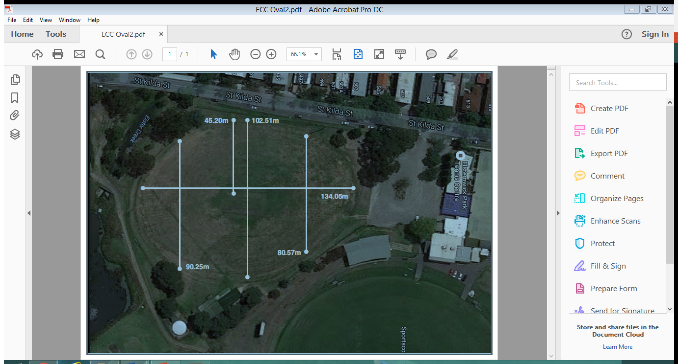

Slide 17
LGA’s and Sport
There are 31 metropolitan municipalities in Victoria.
As seen calculating sports provision is complicated once you factor in population, age, gender etc. You don’t just count # of grounds and include privately owned facilities eg private schools
In a report about the provision of sports Facilities across metropolitan Melbourne
Bayside ranked 27th in sports ground provision (football, cricket, soccer)
Bayside ranked 26th in court provision (tennis, basketball, netball)

Slide 18
Some myths presented last week
EP is a wild place! No its not! Its highly stressed, trees in poor health, horrible water quality and no integrated catchment management plan
The trees are original! At maximum they are 60 to 70 years old. ECC planted many of the trees?
The population is only ageing! Partly correct Its also becoming more youthful
Elster Creek is an open creek! No it’s a DRAIN

Slide 19
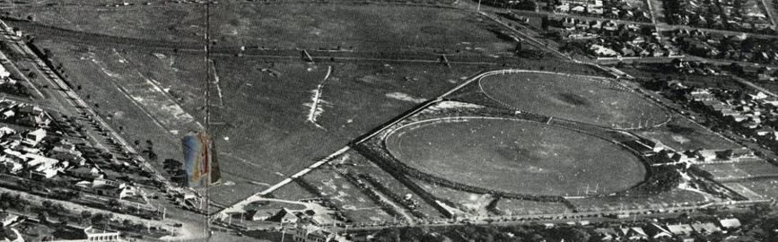
In 1940’s
Note: drain configuration
Distribution of trees?

Slide 20
ECC and EAFC position
Add another oval that is open and can be multi purposed
Remove the fences and even the size of oval 1. Plenty of exemplars for this! Victoria Park, Brunswick St oval. Community purposed
Upgrade facilities to cater for girls and disabled
Integrated catchment management essential
Statistics from Bayside Council
Elsternwick Park North (exc. Tennis Centre, Oval 1 Precinct & Bowls Club) – 154,000 (15.4 hectares)
New Oval 2 Precinct (inc Oval, Pavilion & Nets) – 18,000sqm
This constitutes 12% of available space and leaves the remaining 88% for park/conservation/tracks and passive opportunities
Remaining 136,000sqm or:
2.1 times the size of St. Kilda Botanical Gardens

Slide 21
A Possible solution that could suit most groups
Based on option 2

Slide 22
A previous presenter mentioned
What do you want to be remembered for?
It should be:
A solution that represents all ages, genders and circumstances and ensures a renewal of elster creek systems

