Slide 1
Elsternwick Park (North) Master Plan
Deliberative Panel
5 November 2016
Damien Van Trier
Manager Open Space, Recreation & Wellbeing

Slide 2
Open Space Context
Council currently has 297 hectares of Open Space.
Four public golf courses in Bayside occupy an additional 119 hectares.
Elsternwick Golf Course occupies 12.4 hectares of the northern section of Elsternwick Park.
Golf courses are typically fenced areas given over to the exclusive use of fee paying golfers.

Slide 3
Recreation Context – Allocated Sport
In 2015/16 Council allocated just under 88,000 hours of sport on 43 sportsgrounds.
Allocated sports clubs have over 10,800 members, including 7,182 juniors.
These members supported by an estimated 3,000 volunteers.
Australian Rules and Cricket clubs in Bayside deliver sports programs for over 6,800 children.
Clubs using the No.2 Oval have 960 members including 826 junior sportspeople.

Slide 4
Recreation Context – Golf
Bayside includes four public and two private golf courses.
Golf membership in Australia (and Bayside) in steady decline over the last 20 years.
9 hole golf courses continue to be returned to open space or allocated for other uses by Councils throughout Australia.
Two superior golf options 4 kms away in Brighton and Albert Park.

Slide 5
Recreation Context – Other activities
Bayside residents highly value off-road trails for walking, running and cycling.
Council’s responsibility to provide spaces for informal recreation so families and groups can gather and enjoy the outdoors.
Outdoor spaces for contemplation and conversation are highly regarded by Bayside residents.

Slide 6
Facility Context – Golf
Worst performing golf course in Bayside.
Poor clubhouse and pro-shop facilities.
Course considered too short for vast majority of golfers.
Large portions of course subject to flooding following rain and storm events – sometimes requiring the closure of holes and/or entire course for long periods.

Slide 7
Facility Context – Allocated Sports
No.2 Oval pavilion, sportsground and cricket nets are the worst performing in Bayside.
Each considered Bayside's top recreation priority for renewal and upgrade.
Oval considered too small for senior community sport and is too close to road, wetlands, car park and playground.
Council cannot provide the appropriate upgraded facilities with Oval 2 in its current location – limited space.

Slide 8
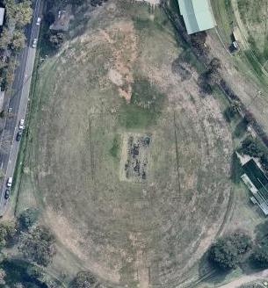
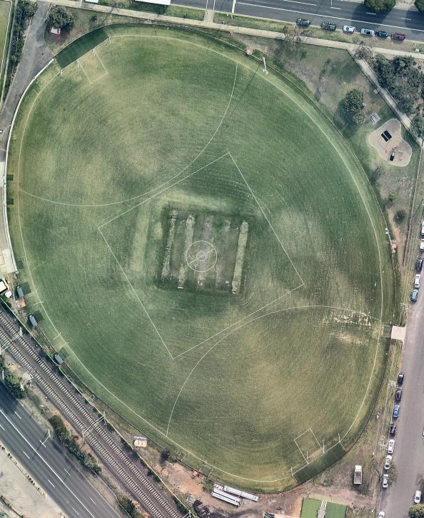
Bayside’s worst oval
Should be like…

Slide 9
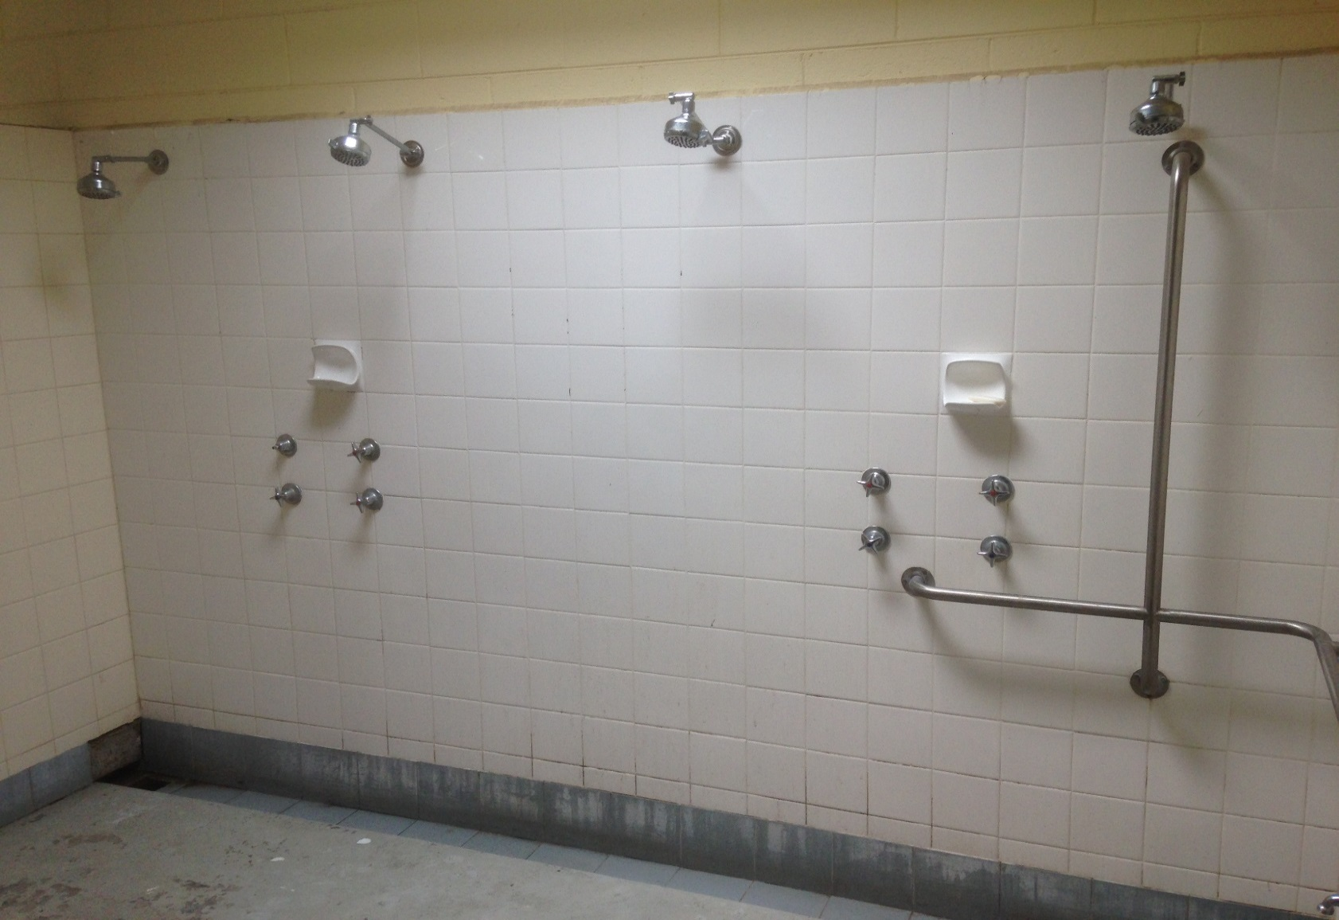
No female should be forced to use these facilities

Slide 10
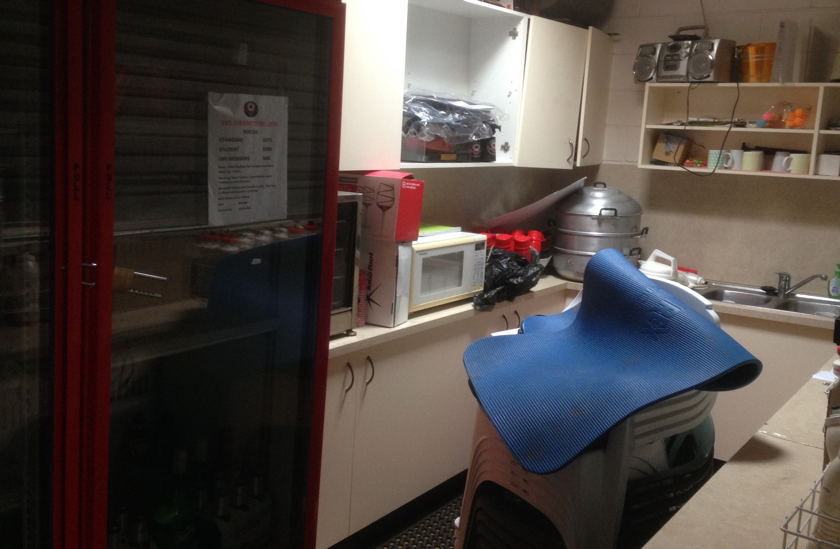
Bayside’s worst canteen – would you volunteer?

Slide 11
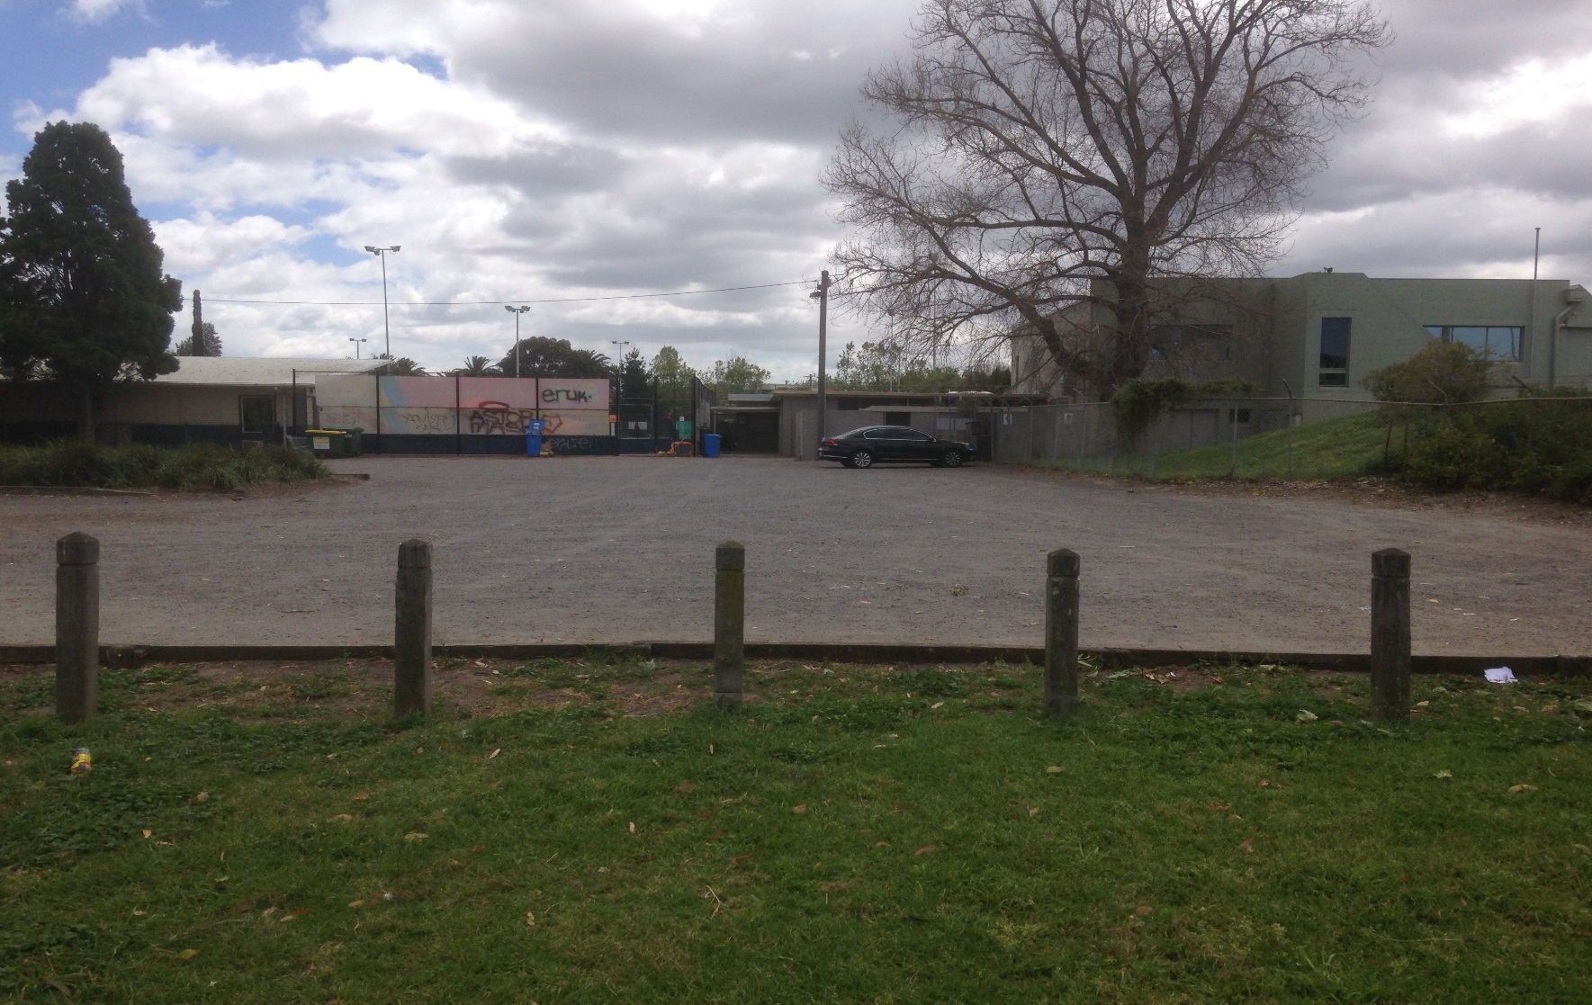
Crossing a car park from pavilion to oval…at night?

Slide 12
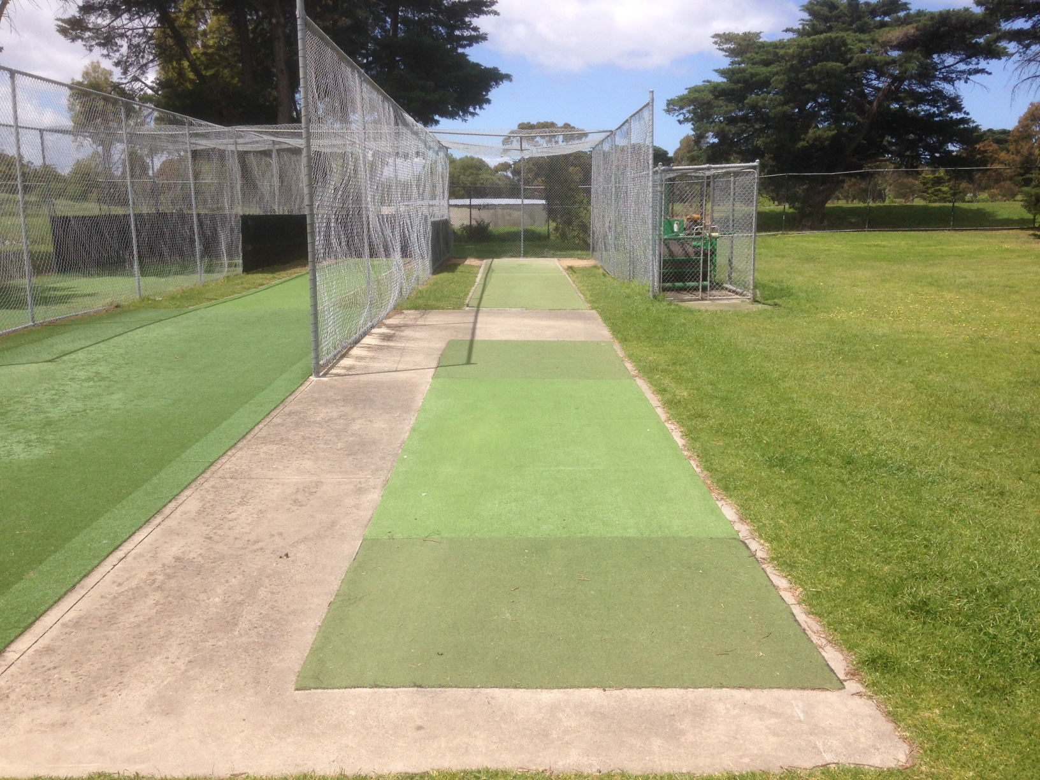
Only cricket nets in Bayside not meeting Australian Standards

Slide 13
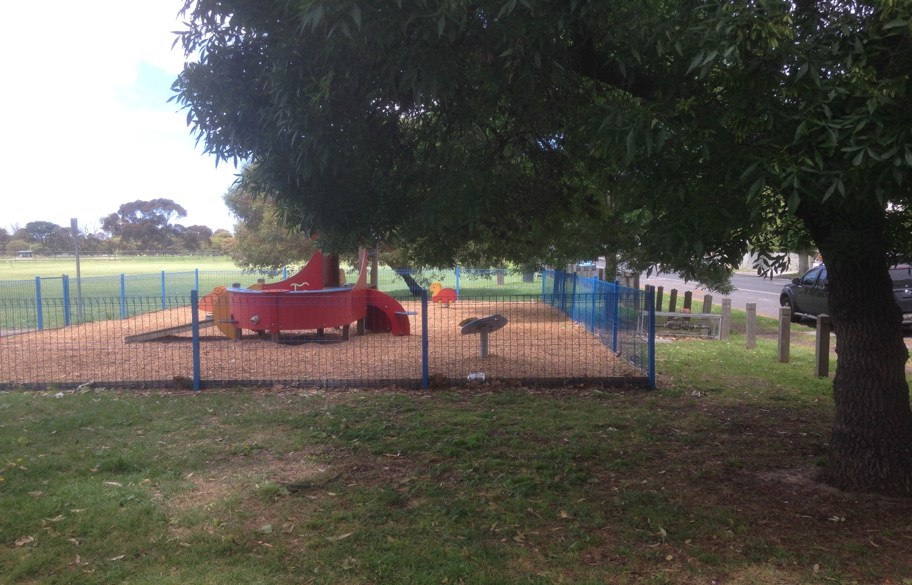
Playground too close to oval and St.Kilda Street

Slide 14
Increasing access to open space
Bayside’s Open Space Strategy includes a high priority for Council to grasp opportunities to increase the open space supply.
Returning the land currently occupied by the golf course creates an additional 12.4 hectares of open space.
Represents a 4% increase in Bayside's open space network.

Slide 15
Community Wellbeing
Accessible and female friendly sporting facilities encourage greater participation and enable all residents to lead a healthy and active life.
Participating in organised sports leads to greater levels of social connectedness and an enhanced feeling of community.
Providing quality open spaces and recreation facilities improves local residential amenity.

Slide 16
Questions?

