Slide 1
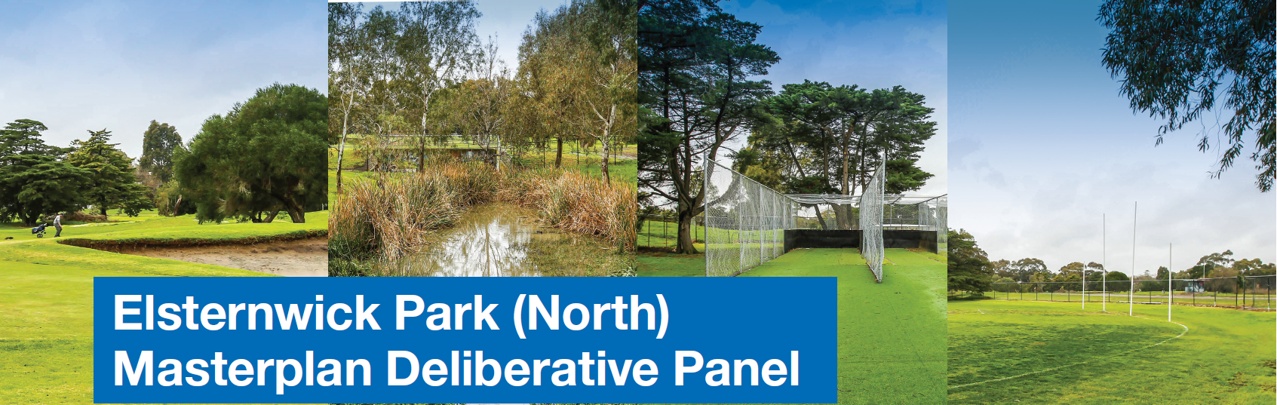

Slide 2
Acknowledgement of Country
We acknowledge that the original inhabitants of this land that we call Bayside were the Boon Wurrung people of the Kulin nation.
They loved this land, they cared for it and considered themselves to be part of it.
We acknowledge that we have a responsibility to nurture the land, and sustain it for future generations.

Slide 3
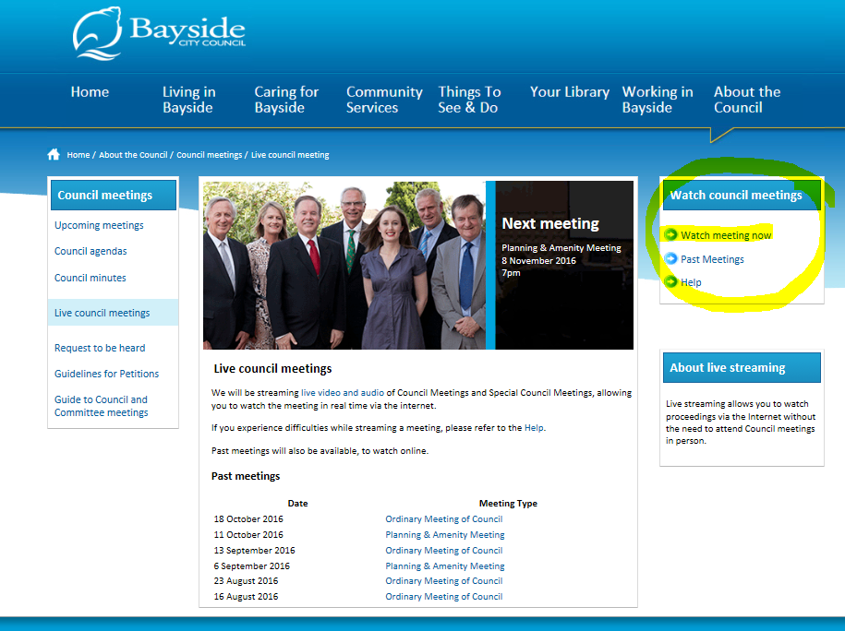
Watch this from home live!
http://stream.bayside.vic.gov.au

Slide 4
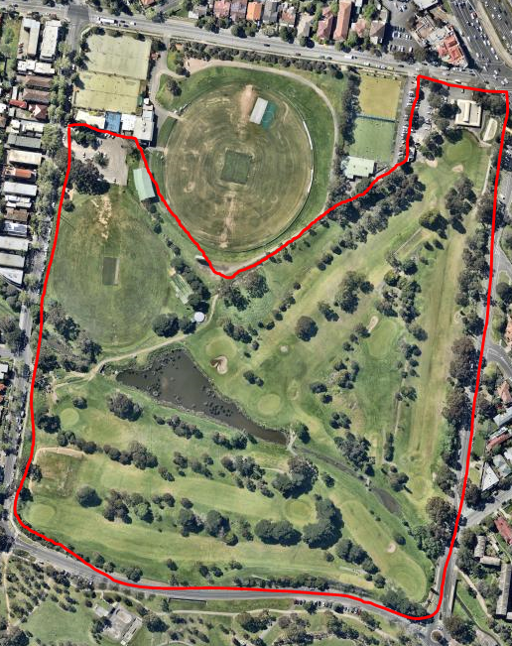
Project Background
Almost a year ago Council resolved not to proceed with a driving range at Elsternwick Park Golf Course and undertake broad community consultation regarding the future of the site, including:
Retention of the golf course
Preferred location for Oval 2
Turning the golf course into open space
Any other viable options - eco precinct, nature based park

Slide 5
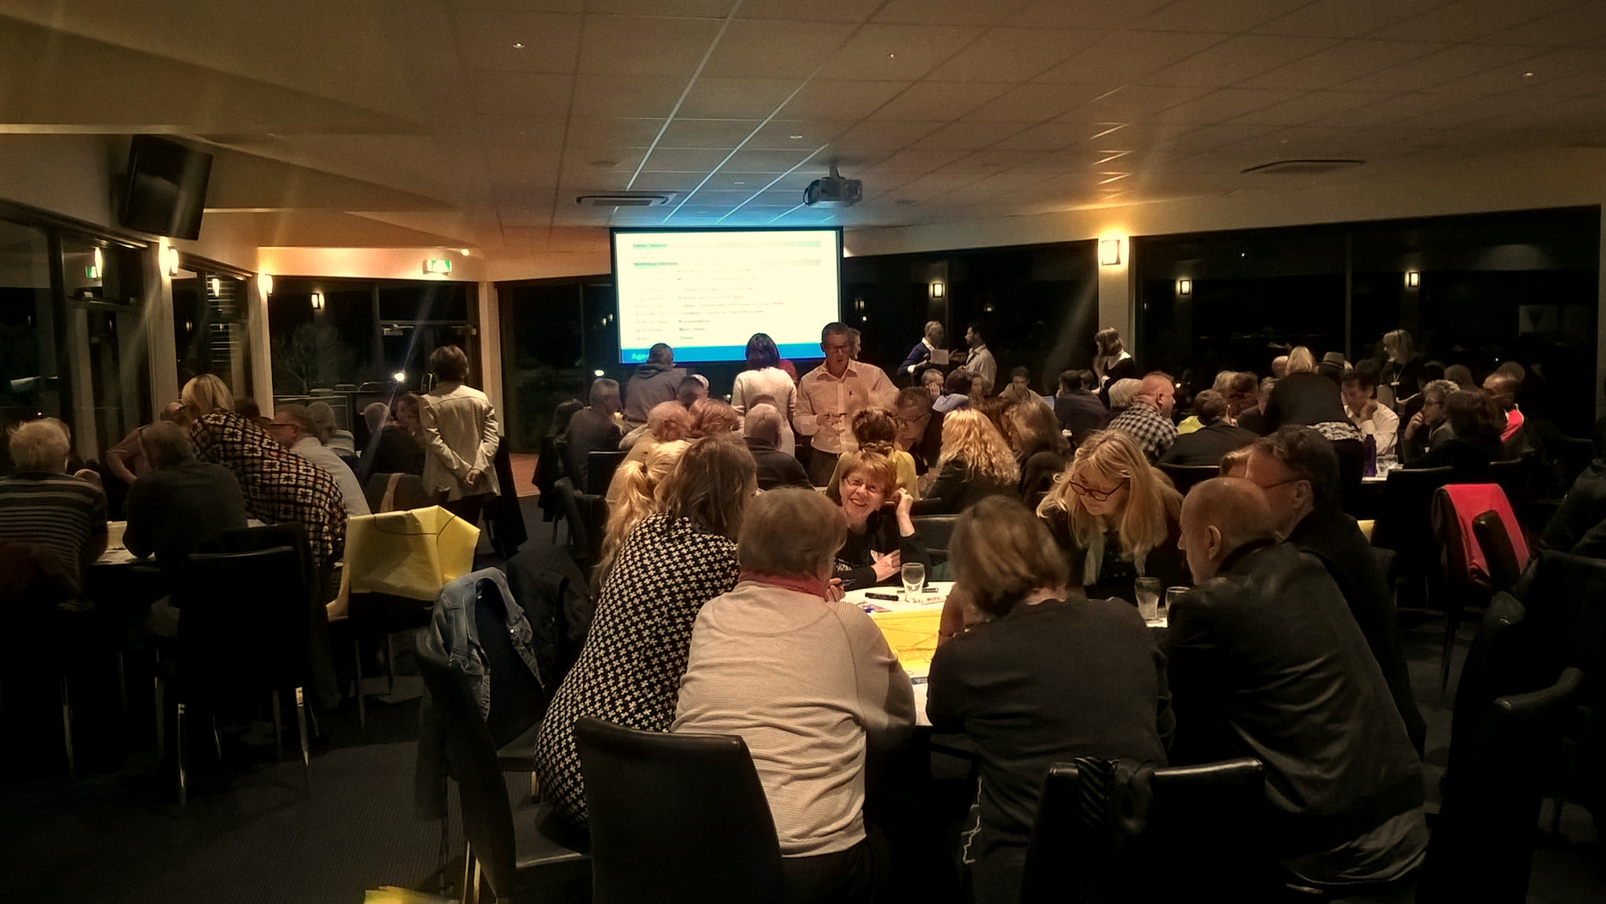
Consultation Process
62
ideas
Option 1
Option 2
Option 3
248 People
93 People

Slide 6
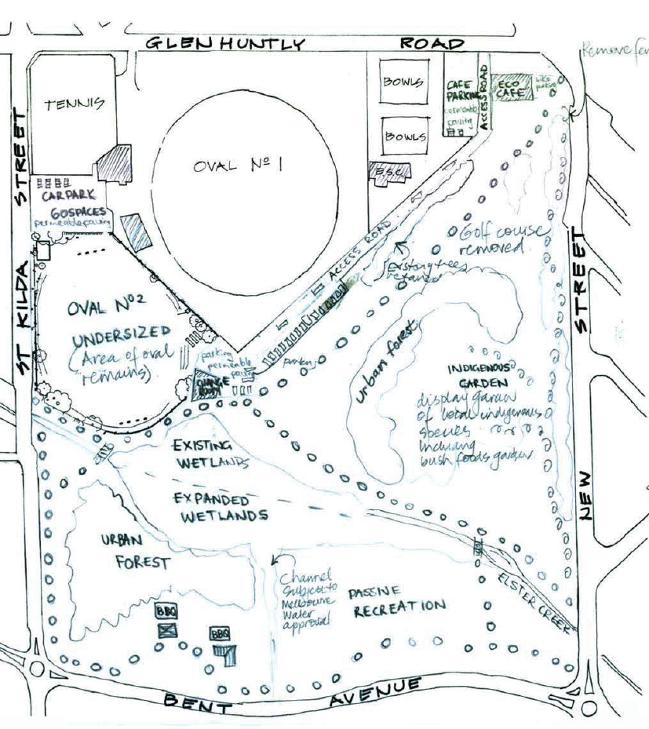
Option 1
Open Space, Environment and Sustainability
Key Features:
Increased planting – urban forest
Indigenous garden
Expanded wetlands
Increased pathway
Eco-Café (in existing building)
Oval 2 retained in existing location

Slide 7
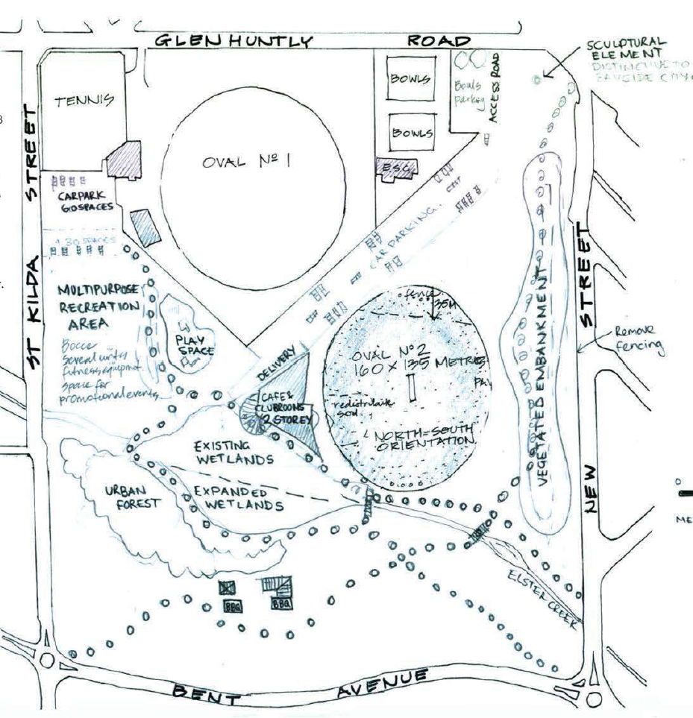
Option 2
Play, Community and Open Space
Key Features:
Resized Oval 2 – new location
Increased planting – urban forest
Indigenous garden
Expanded wetlands
Increased pathways
Eco-Café (in new pavilion)
Informal recreation area and play space

Slide 8
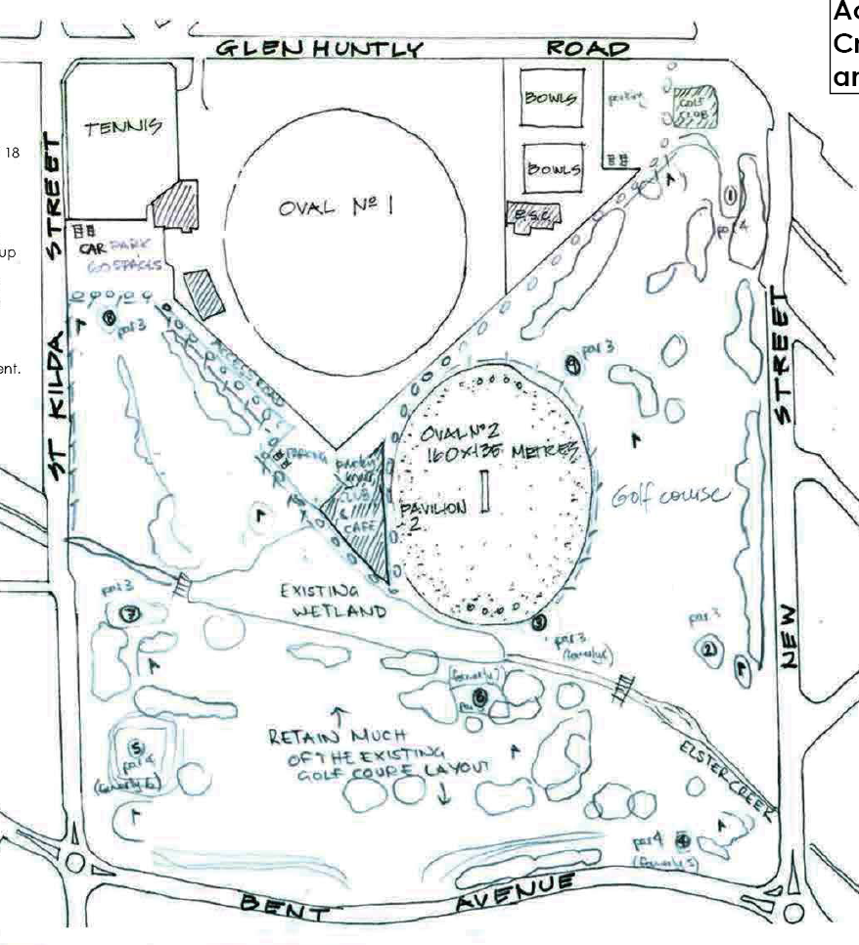
Option 3
Active Sports, Play and Community
Key Features:
Resized Oval 2 – new location
Resized 9-hole golf course
Increased planting
Increased pathways
Eco-Café (in new pavilion)

Slide 9
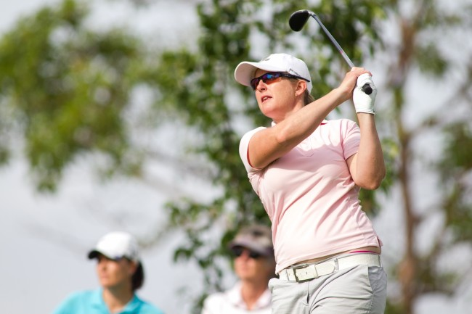
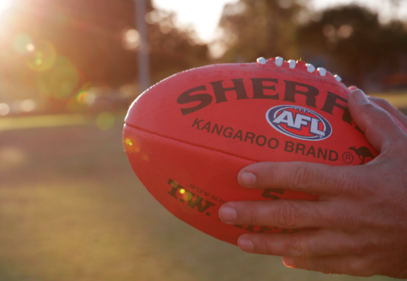
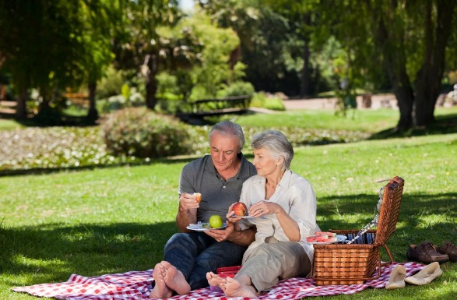
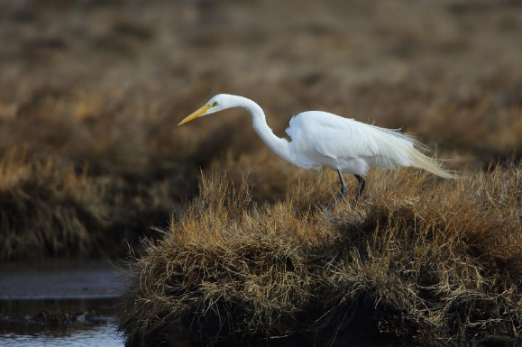
Importance of Elsternwick Park
1000
Involved so far

Slide 10
Thank You and Ongoing Process
Big thank you to:
Panel Members – making a commitment to understand and deliberate the future of Elsternwick Park.
Presenters – for bringing your passion, knowledge and understanding of your subject to the panel.
Broader community – here at Council chambers, those at home and involved previously. Your ideas, patience and enthusiasm for the process have been of immense value.
We will take the recommendation from this meeting to Council in February 2017 and will publicly respond to the proposal put forward.

