Slide 1

Elsternwick Cricket Club Presentation to EP Deliberative Panel
John Dunnachie
President ECC

Slide 2
Elsternwick Cricket Club
A sporting club that formed in 1900 and
has had its home at Elsternwick Park since 1903
A Club that has had the longest continuous occupancy and stewardship of Elsternwick Park of any group
Managed and funded work at EP until the onset of the Great Depression
Every weekend in summer there are 16 teams representing ECC (2016/17 season figures)
ECC plays in the second highest cricket competition in Victoria
High levels of community involvement

Slide 3
Current Membership
Around 180 playing members
Over 100 social members
25 life members
4 senior teams
11 junior teams
1 over 60s team
Large “In 2 Cricket” program for 5-9 year olds
Many members would like to be here in the gallery today if it wasn’t a Saturday and matches being scheduled

Slide 4
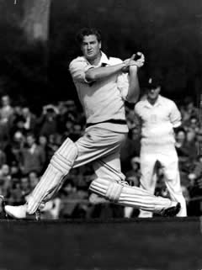
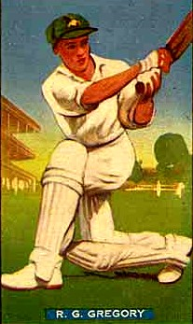
Notable Players with Links to ECC
A number of Australian players
including Keith Miller
and Ross Gregory
Numerous Victorian players including Cameron White (current patron), Aidan Blizzard, Norman Blundell
Numerous representatives at other levels including junior state teams, current U16 Australian captain, premier cricket etc

Slide 5
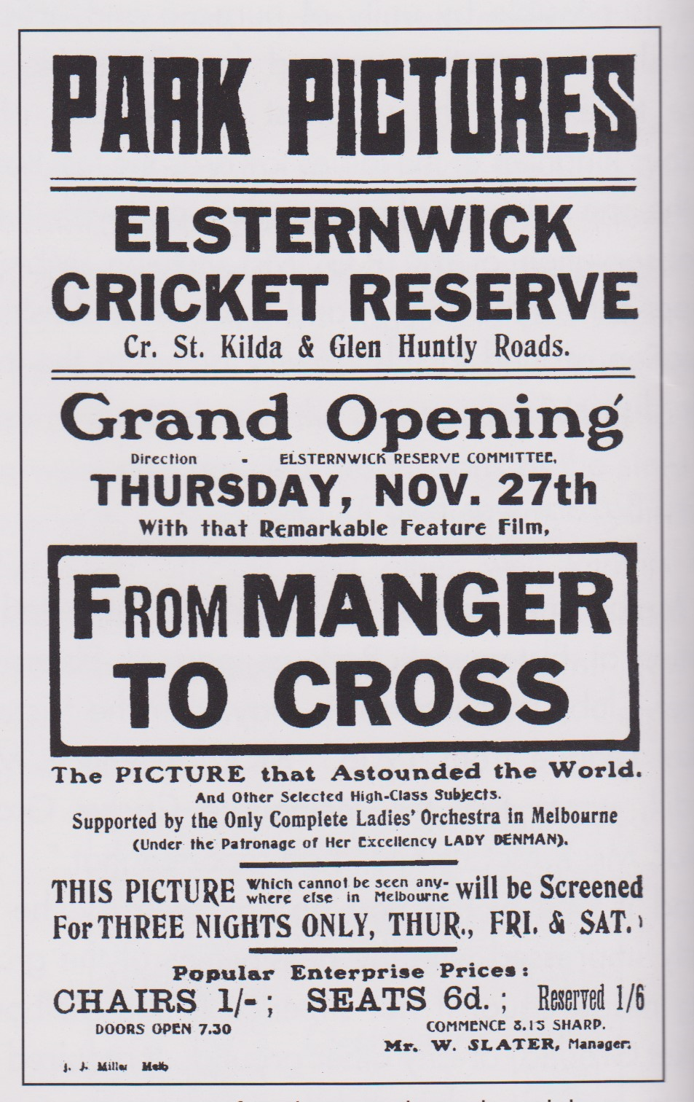
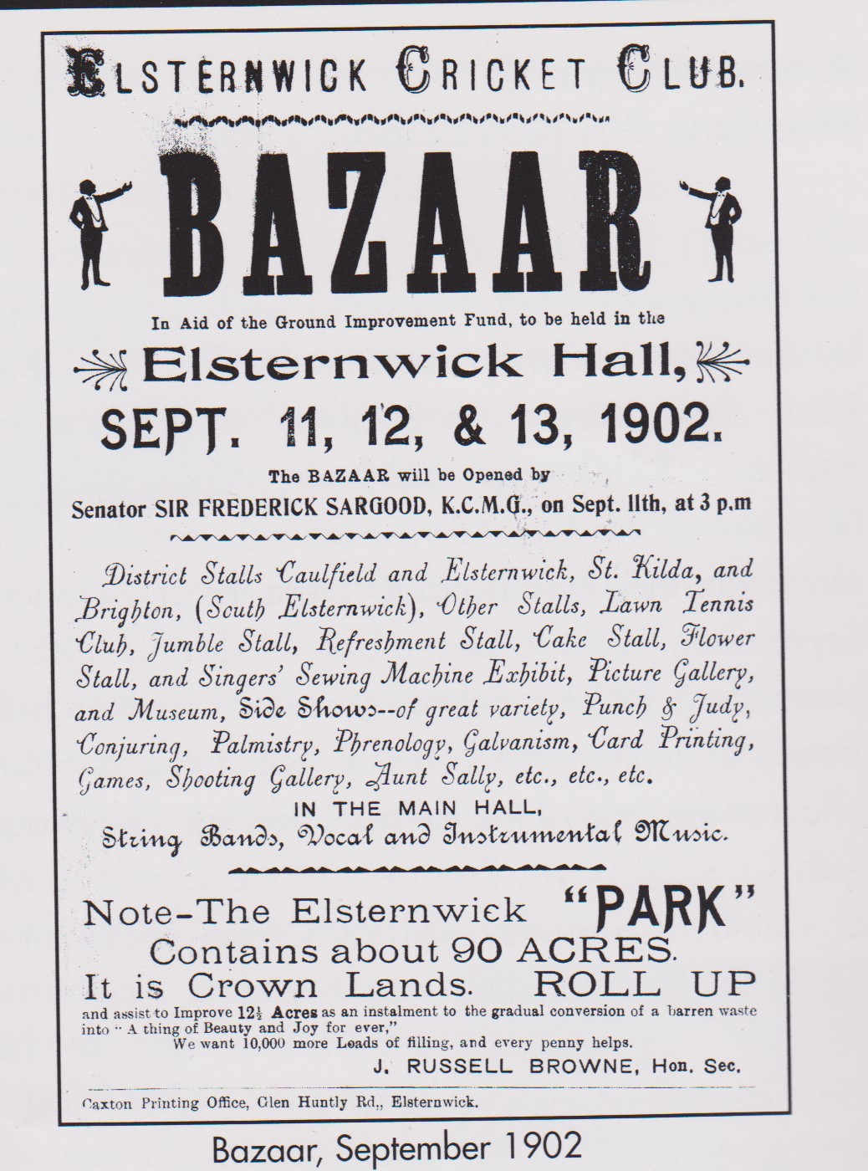
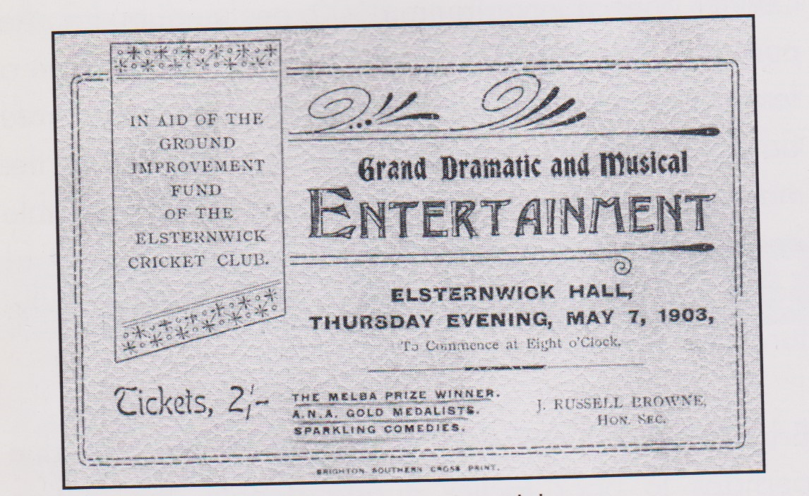
A Brief Overview of ECC and EP
There were no public sporting grounds prior to 1900
ECC raised the money to construct the main oval via bazaars, musical evenings and the like, after the 3 bordering councils refused to provide funding stating that “residents from other municipalities
would benefit”.
A statement that still
rings true today.

Slide 6
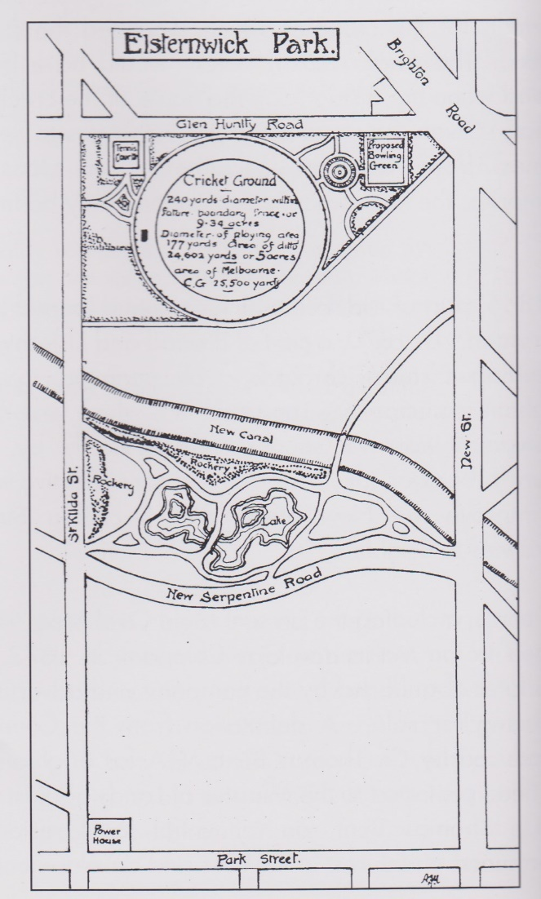
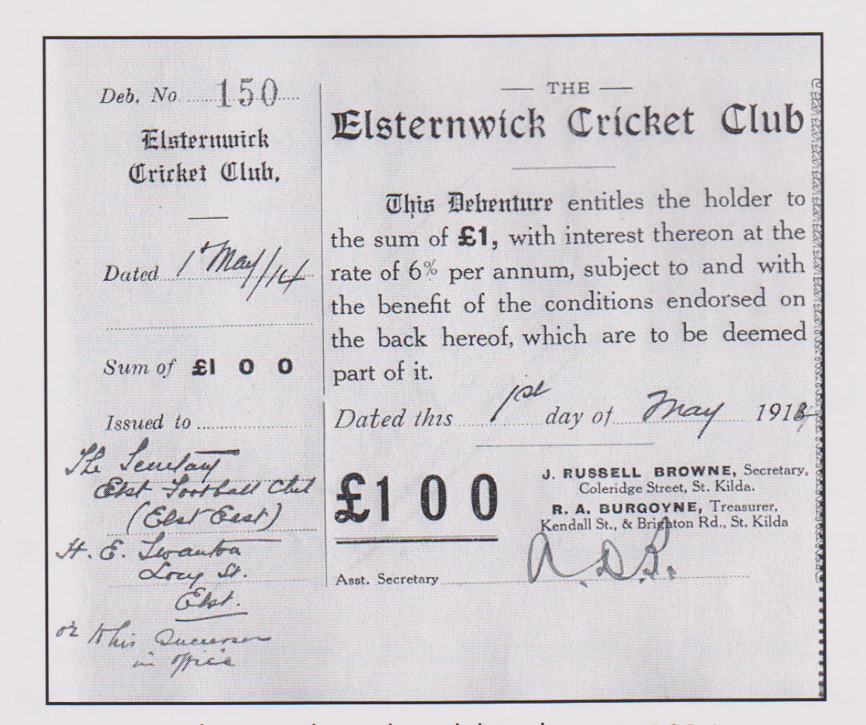
ECC and EP Overview (cont)
ECC commissioned the design of EP North and the original design is below. Intention to create an attractive precinct with active sport at centre. Oval dimensions the same as the MCG.
Debentures sold to raise money

Slide 7
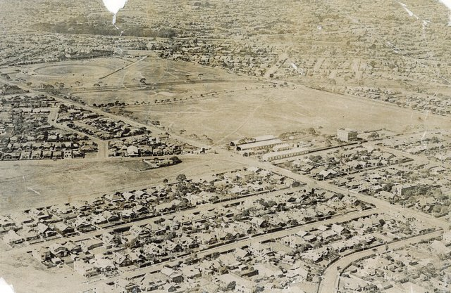
EP 1933 (source: National Library of Australia)

Slide 8
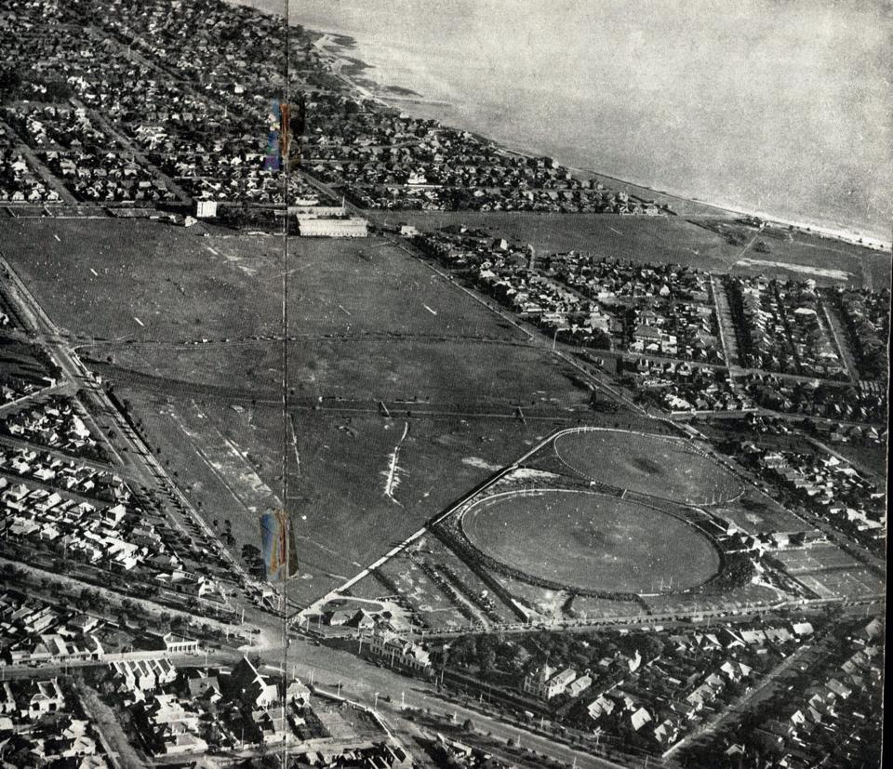
EP circa 1939

Slide 9
Aerial Photos tell a story
EP was a stark and barren landscape
Trees were very few and far between
EP North not beautified and revegetated until after WW2
EP North since work started in the early 1900s has always been an active sporting precinct
Today this includes cricket, football, golf, tennis and bowls and in the past soccer, rugby and baseball

Slide 10
Issues stemming from Changes to EP in 1990s
The demographics of the area was dominated by people over 60. Today this has significantly changed
Decision to make EP South essentially an area for passive has impacted on the availability of active sport facilities available to locals today
Bayside is ranked lowly in comparison to other councils in relation to active sporting spaces. # 27 in Victoria
EP South has 15.5 hectares of space of which 1.5 hectares is used for active sport

Slide 11
ECC in 2016
Highest number of junior teams in ECC
history with 11. Volunteers manage each team
ECC could run more junior teams, girls and women’s teams but doesn’t have enough grounds
ECC needs 2 full size grounds to run existing senior program and 3 other grounds for junior program
Stark contrast to 1990 when Elsternwick Park South lost many of the active sporting facilities. At the time ECC had 1 junior team and 5 teams in total
ECC recognised as a major breeding ground for talented cricketers. Current U16 Australian captain is an ECC product

Slide 12
Current Issues
The club does not have enough facilities to cater for the demand from juniors that is only expected to increase
ECC would like to introduce girls and women’s teams
Lack of unisex change rooms and facilities
Oval #2 is too small, too close to St Kilda Street and has been in limbo for a decade whilst decisions to upgrade the ground have been deferred
The pavilion for Oval #2 is situated across a public carpark, making it unsafe for both senior and junior players to access
There is no cover for participating teams to shelter from the summer sun on Oval #2

Slide 13
Current Issues
Oval #2 in ranked currently by Bayside as a low level facility, therefore does not receive the maintenance that other ovals do even though it is used for senior cricket and football
Oval #2 is undersized for cricket with new bat technology making this an even bigger safety issue
Oval #2 has an exceptionally poor surface and some games have had to be relocated
The facilities for thirds and fourths players are detrimental to developing player talent
The practice facility upgrade continues to be deferred pending the outcome of the EP North Masterplan. In addition, upgrade of the No.2 Oval Change Rooms / Pavilion has been top of the Bayside Pavilion upgrade listing, but has been deferred pending outcome of the EP North Masterplan. These are now the worst in Bayside

Slide 14
ECC and the community
ECC has been an integral member of the local community and has supported numerous groups and enterprises Examples include:
Bayley House annual events for last 15 years
Revegetation projects within EP
Development of community facilities eg training nets
Annual Red Cross collection
Coaching provided to a range of groups
Strong links with other tenants of EP.
Good Sports accredited club - Level 3

Slide 15

Bayley House

Slide 16

GOOD SPORTS – LEVEL 3

Slide 17
Why have sporting clubs?
Increased community connectedness
Development of social capital and values important to a well functioning society
Economic multiplier in local community
Stewardship of resources in area
Encourage participation and healthy lifestyles
Studies by the AFL show that “for every $1 spent to run a club, there is at least $4.40 return in social value in terms of increased social connectedness, wellbeing, and mental health status; employment outcomes; personal development; physical health; civic pride and support of other community groups.”

Slide 18
ECC’s preferred options
Option 2 first as it expands options for active recreation and will cater for increasing demands due to population increase and female sport
Option 3 second as it adds a full size second ground and removes the dangers of Oval #2
Option 1 last as it does not solve issue of undersized second ground and reduces options for active sport even further

Slide 19
Inherent in any redevelopment of EP
ECC in having desired outcomes for EP North would hope that:
Fences around EP are removed
Water issues are resolved upstream of EP
Continue revegetation around new facilities and better connection within EP North eg pedestrian trails, bike paths etc
A new oval or ovals and pavilions will be an integral part of any new development.
Formal usage of ovals requires about 30 hours a
week leaving much time for informal uses

Slide 20
Reasons behind ECC’s views
The club must have at least 2 grounds with
turf centre wicket areas to keep its affiliation
with the Victorian Sub District Cricket Association
Population in the local area is increasing and demand for active sporting facilities is increasing
The second oval is too small and with playgrounds and BBQs being added in recent times has resulted in some dangerous situations
A newly built oval to Australian sporting standards to incorporate a turf centre wicket area and 2 hard wickets on alternative flanks of the ground for junior cricket, giving the club access to 3 new wickets

Slide 21
Data to support ECC view
Year | Elsternwick Primary School Enrolments | Elwood Primary School Enrolments
2008 | 442 | 485
2009 | 448 | 548
2010 | 468 | 619
2011 | 535 | 649
2012 | 561 | 720
2013 | 580 | 742
2014 | 599 | 735
2015 | 628 | 768
In total there were 927 primary school students in 2008. In 2015 the are 1396, an increase of more than 50% in 7 years.

Slide 22
ABS Population Data
Bayside – 103,110 to 118,650 (15% growth) - http://forecast.id.com.au/bayside
o Glen Eira – 146,985 to 178,375 (21% growth) - http://forecast.id.com.au/glen-eira
o Port Phillip – 106,874 to 130,207 (22% growth) - http://forecast.id.com.au/port-phillip
Population in Bayside, Glen Eira and Port Phillip is estimated by the ABS to increase by an average of 20 percent in the next 20 years over the 3 municipalities.
Bayside 103,110 to 118,650 (15% growth)
Glen Eira 146,985 to 178,375 (21% growth)
Port Phillip 106,874 to 130207 (22% growth)

Slide 23
In Summary
This area is changing demographically and quality facilities need to be provided that meet future population projections as well as changing attitudes in society. Option 2 does this
Sporting clubs are important to the social and economic fabric of any community and ECC has a demonstrated track record here. Option 2 will enable increased connectedness
Existing facilities are inadequate and an urgent solution needs to be found. Facilities must be safe and fit for purpose. Again Option 2 addresses this
EP North needs a new full sized Oval #2 or 2 new ovals, and adjacent female friendly pavilions and new cricket nets to replace the current infrastructure

Slide 24
A mothers perspective of ECC
Mother’s perspective of Elsternwick cricket club
I had no involvement with cricket growing up. Except for watching my brothers bowl in the driveway. It was when my children went to primary school I became part of the community of Elsternwick cricket club. Originally, through the junior Vic-cric cricket program then onto juniors and now seniors.
Healthy lifestyle - With a food and nutrition background I was very keen to give my children a balanced lifestyle which included exercise and time outdoors. We have a growing obesity problem in Australia due to the sedentary lifestyles of so many children. Playing cricket is a fun way to exercise and while being part of a team.
Social skills - I was thrilled to have my children mixing with children not necessarily at their school. The club has always maintained their fees at a very reasonable rate to allow children from all socio economic backgrounds to join.
Becoming part of the community - As a family we were always at the matches . I relished the opportunity for the little brothers and sister to play on the sidelines while their siblings played cricket .As parents an opportunity to meet others in the community and forge new friendships.

Slide 25
A mothers perspective of ECC
Social conscience - What I have found unique to cricket and Elsternwick is the need to become involved . Give of your time & talents. I have fond memories of wheeling the afternoon tea down to elsternwick park on a Friday night. The fundraising occasions for suicide prevention, the pink day to raise money for breast cancer research and Family day matches. Annually Elsternwick organise a fun day with Bailey House Brighton. We have a cricket match between the Bailey house adults and our cricketers . The joy this brings is hard to describe. So much more than winning games . The cheering & laughter during the match . The smiles as a community share a sausage sizzle. When the days awards are announced it is heart warming. I reflected how my kids may have not had contact with people with disabilities if it wasn't for this day.
Resilience and discipline -As my sons have progressed into upper secondary years the physical exercise of mid week training & games form part of a successful study schedule. Balancing study and physical exercise to ensure good mental health . My eldest son said the discipline of cricket, the pressure to perform & be strategic helped him with the rigors of VCE .
Building self esteem and sportmanship- Presentation nights where every child received their statistics & were praised for their unique skills. That is not an experience I have had at any other sporting club.

Slide 26
A mothers perspective of ECC
Community involvement -I am thrilled to see my 17 year old giving back to the club & coaching the juniors. A commitment of training the young cricketers and match attendance. We can tell children they need to get involved but it is great role models that make the difference.
People have asked why cricket it is all day Saturday. Yes it is all day but the rewards are great fitness, teamwork skills, sportsmanship & resilience.
No gender barriers - Elsternwick cricket club welcomed my youngest daughter to the club. She played in an all boys team & fell in love with the game. She has gone onto played regional cricket & is part of the state development squad.
Regards
Lisa O’Shannessy
Mother of Hugh, Henry and Ava Bennett

