Slide 1
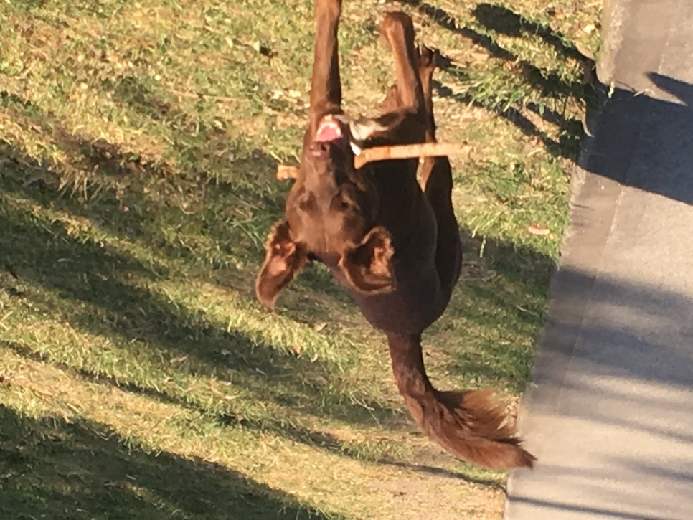
Don Robertson - Nearby Resident
My Connection with Elsternwick Park (North and South)
Lived nearby for nearly 15 years, previously lived in Elwood
Three sons who have either:
  Played cricket (junior and senior)
  Played football (junior)
  Umpired football (junior)
  Played tennis
  Played golf (not often, and not very well!)
  Used the bowls club for a private function
Family who:
  Walk our two dogs on a daily basis
  Use the park for fitness
  Use the park for organised sport (cricket, football)
Well aware of:
  The role sporting clubs play in the nurturing of children in this day and age
  Need for more sporting facilities for girls (and women) - netball courts?
  Increased demand for junior football (boys and girls)
  There are not too many ovals in Bayside, as some would want you to believe
The entire park is a well-used resource for passive and active recreation
  Passive - reading, kite flying, model planes, skate park, dog walking, fitness, walking, sitting, kicking a ball, frisbee, children’s playground, nature watching
  Active - cricket (summer and winter), football (junior and senior), golf, bowls, tennis
Royce ridding Elsternwick Park of sticks

Slide 2
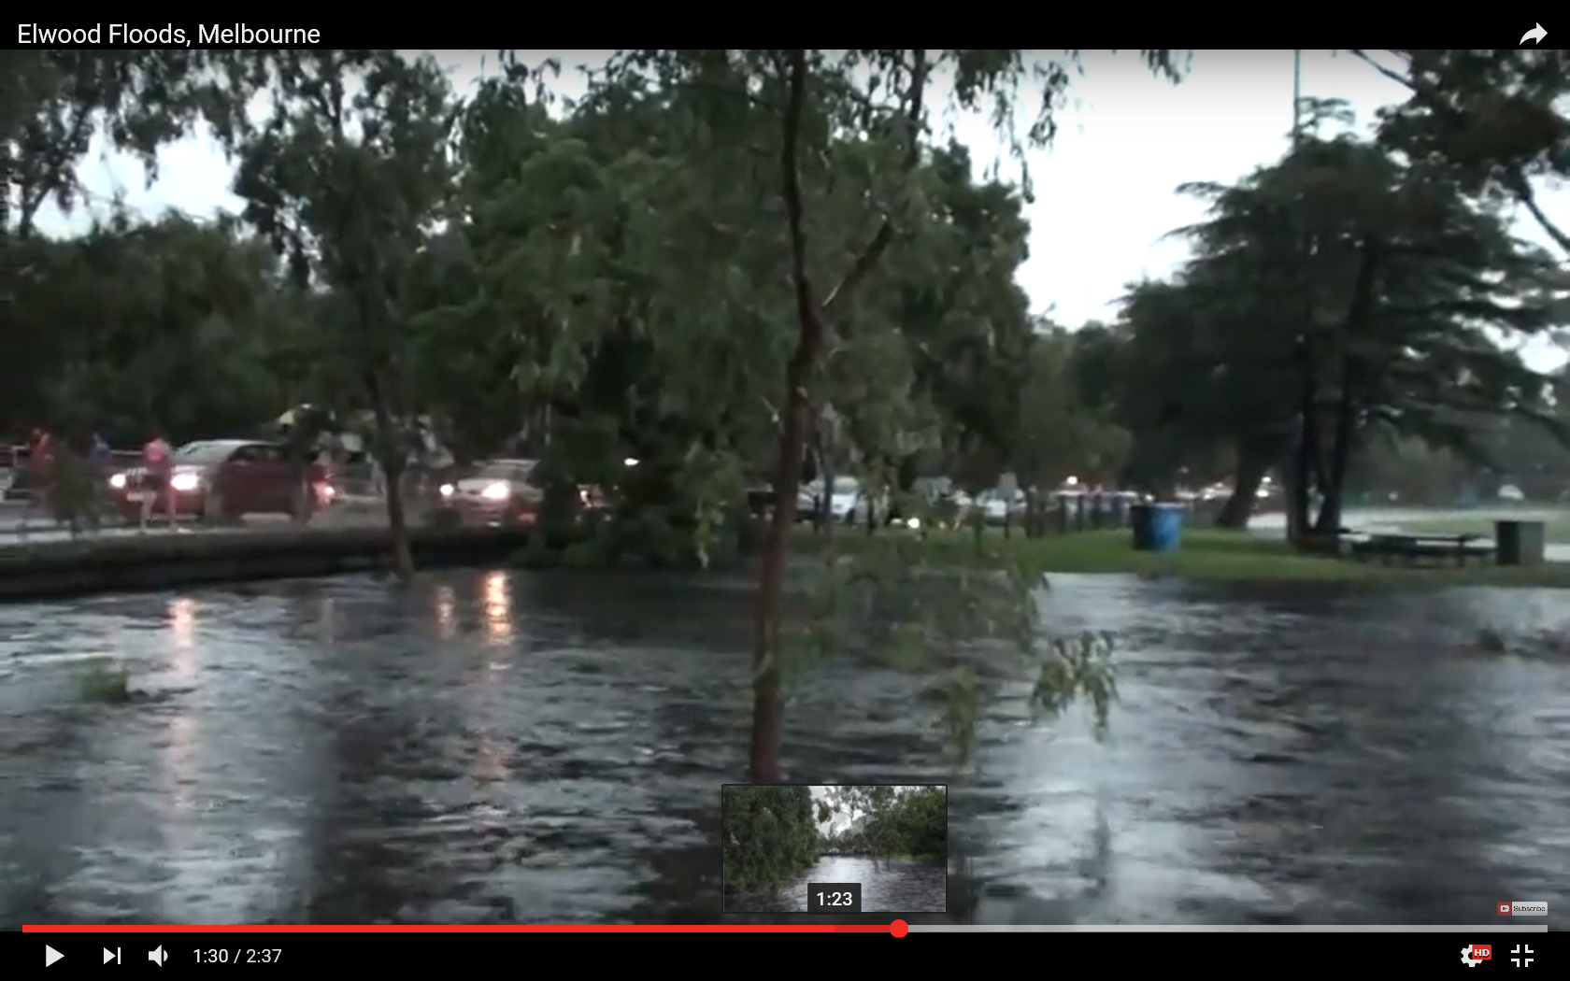
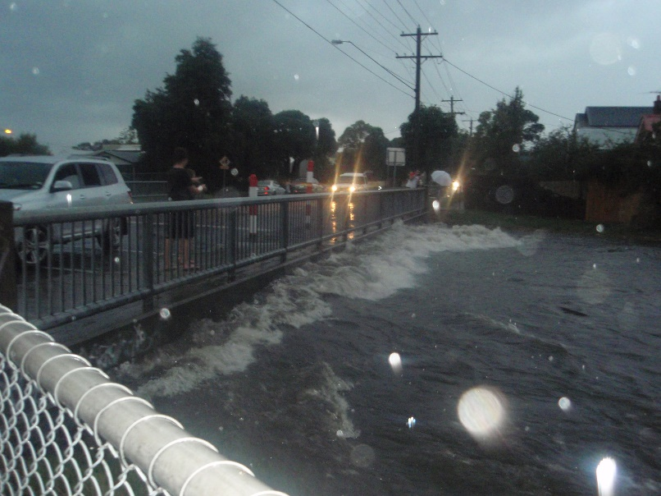
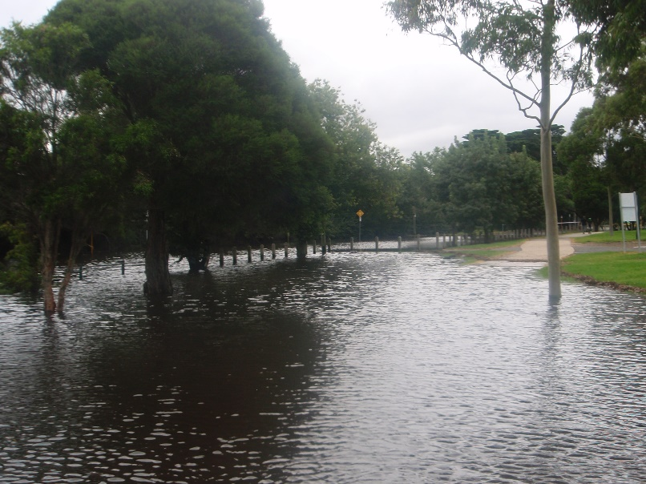
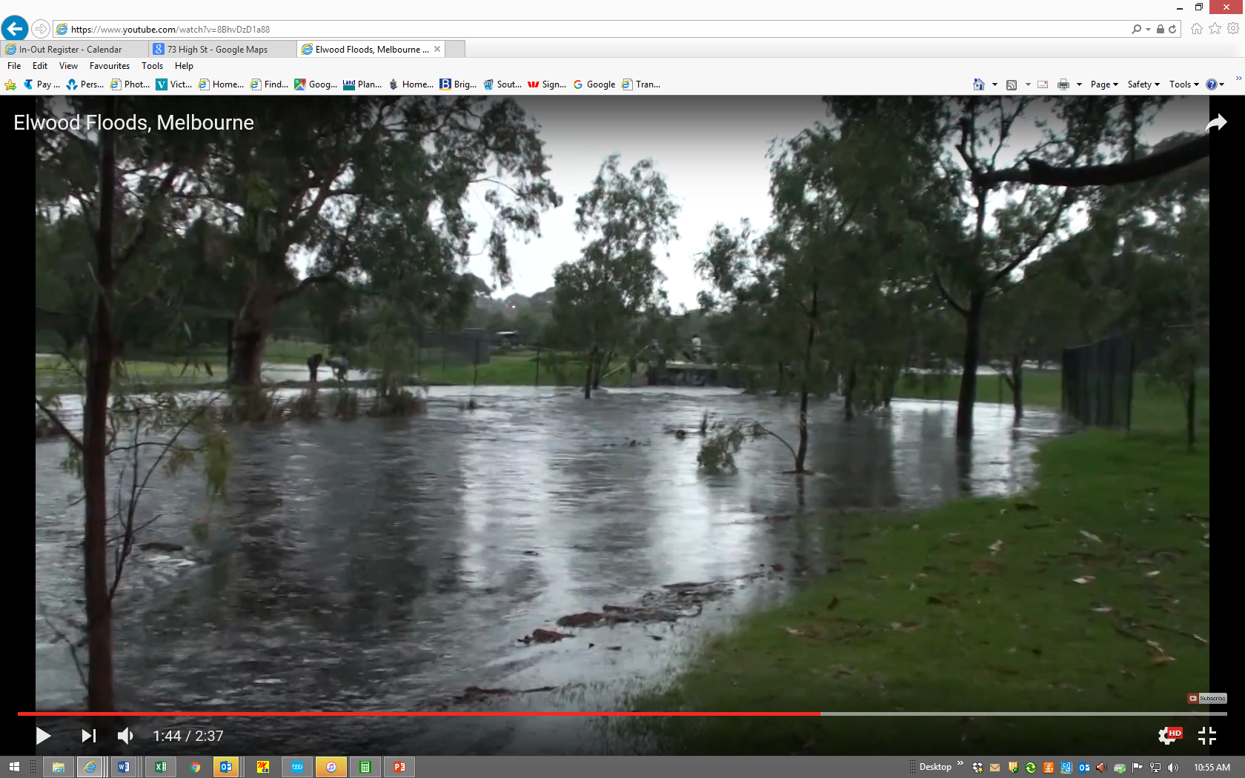
Don Robertson - Nearby Resident
My Aspirations for Elsternwick Park North
Flood mitigation - first and foremost
  Major floods:
    1955 - resulted in the Head Street diversion drain
    1989 - late summer
    2011 - February
      Worse than 1989
      Significant flooding downstream
      Flooding upstream
      Elsternwick Park functioned as a retarding basin
        But, was (is) it adequate?
  Impact of global warming on storms intensity/size/frequency) and sea levels?
St Kilda Street and Oval #2 - late afternoon
Cochrane Street bridge - late afternoon
Bent Avenue - next morning
Oval #2 and Bent Avenue culvert - late afternoon

Slide 3
Don Robertson - Nearby Resident
My Aspirations for Elsternwick Park North
Recreation
  Formalised activities can readily coexist with informal use (as per Elsternwick Park South)
  Upgraded Oval #2 is vital for the benefit of our kids (pavilion, change rooms, cricket nets, two junior pitches, etc)
  Playing fields can be part of the flood management system
  Netball courts and other facilities (playground?)?
Environment
  Water quality : Yes
  Urban forest: No - impact on water flow?
Golf
  Doesn’t allow for unrestricted access
  Constraints placed on possible solutions by not including bowls club
  Alternatives are nearby
  Sadly, may need to go? Financial implications?

Slide 4
Don Robertson - Nearby Resident
My Thoughts on the Options
Option 1
  An undersized Oval 2 is not appropriate
Option 2
  Preferred.
  Use former Oval 2 for netball courts?
Option 3
  Acceptable
  But impact of errant golf balls?
General Comment
  All options are constrained by the decision to not include the bowls club, and even part of or the whole of Oval 1, in the discussion
  This affects the potential retention of the golf course

Slide 5
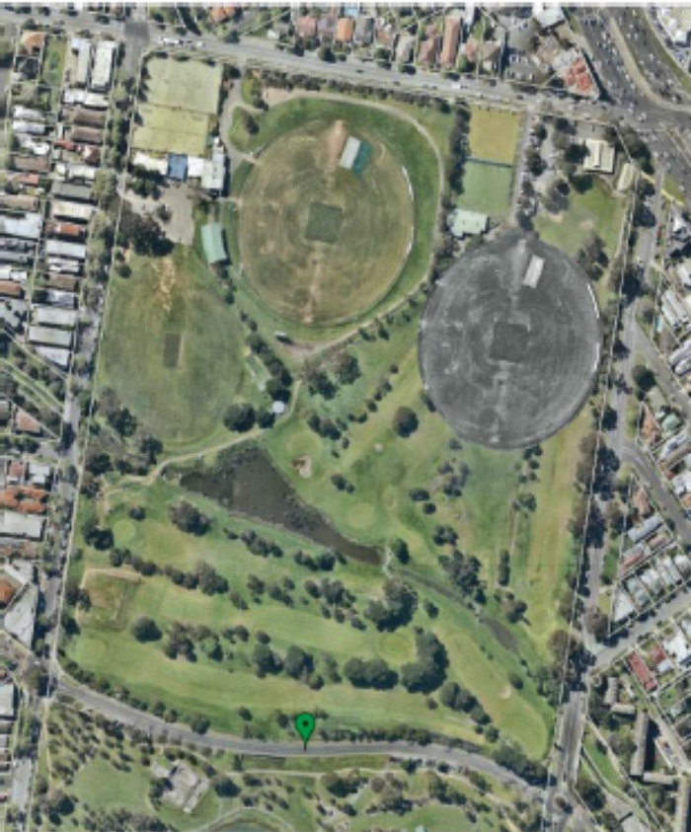
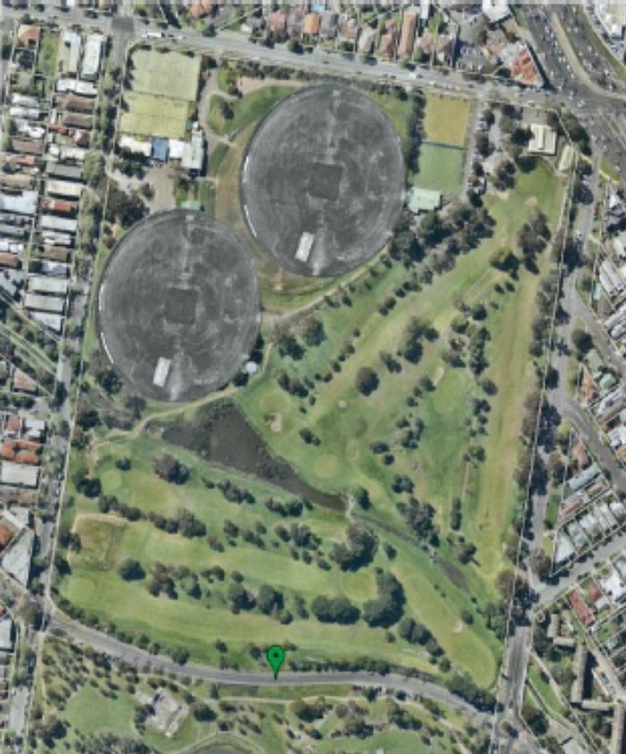
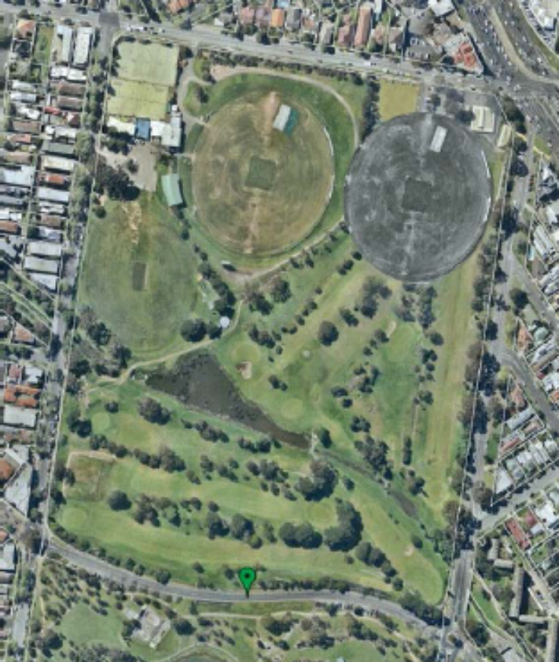
Don Robertson - Nearby Resident
My Thoughts on the Options
Alternatives?

