Slide 1
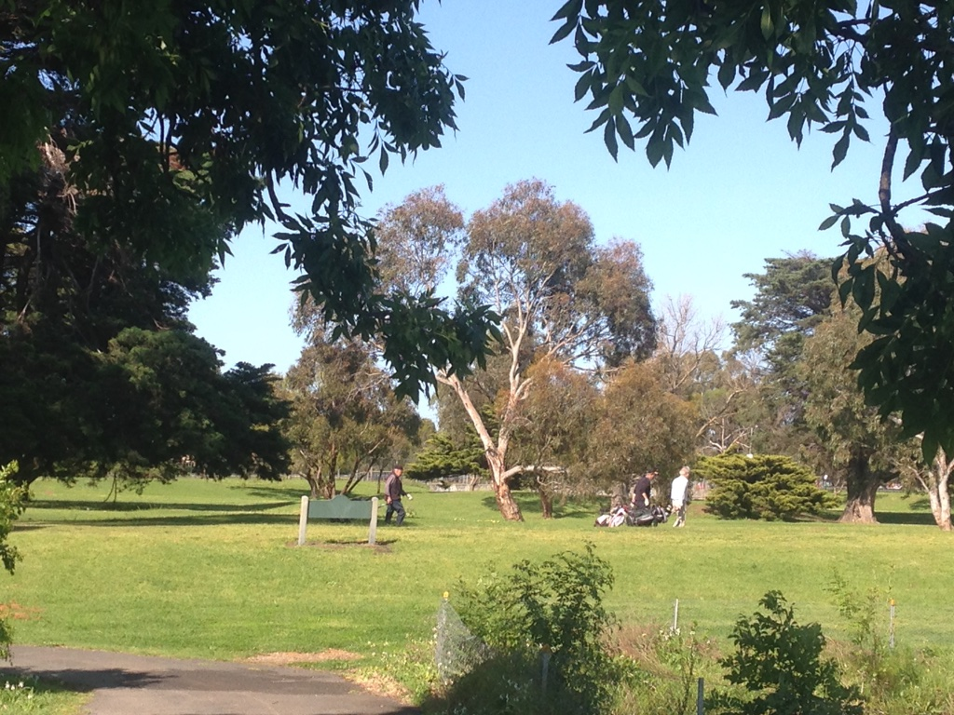
Elsternwick Park - the future?

Slide 2
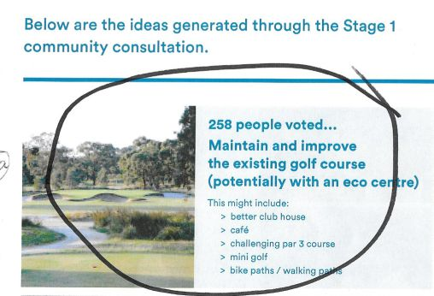
Results of voting at the Consultation Session indicated 398 in support of golf.

Slide 3
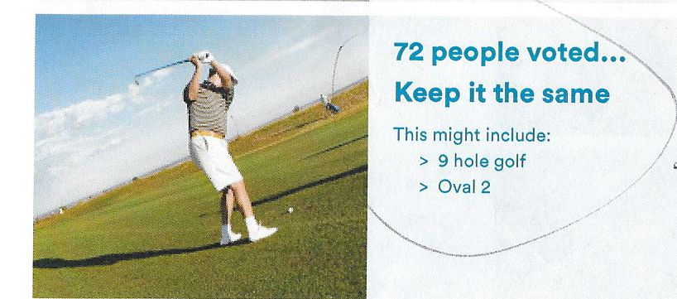
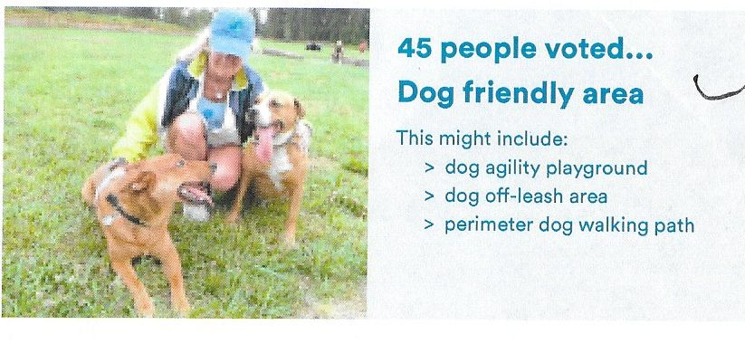
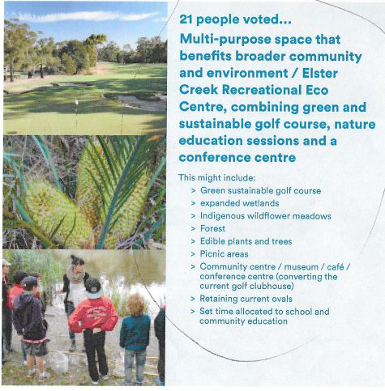
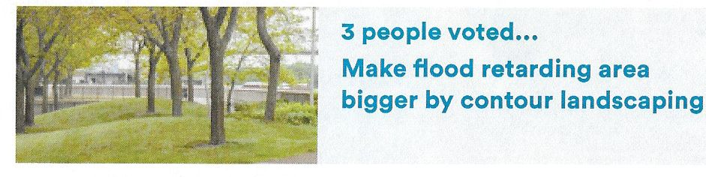

Slide 4
Criteria for assessment
The suggested use should allow the park:
to be managed and maintained in good condition
to be utilized by many people of all ages throughout the whole week
preserve the history and 100+ yr old trees
maintain neighbouring residents’ quiet enjoyment of the area
to be kept secure - unwanted activity is deterred
to support a big range of open space community activities
to be a flood mitigation area
be a cost effective asset for Bayside residents

Slide 5
Why golf?
Golf is still played by a lot of people. Why?
Benefits: Health, Fitness and Social.
One of the objectives of Bayside Council is to provide an environment that contributes to the health and well-being of residents. Retention of the golf course will assist in achieving this.
http://www.ed.ac.uk/news/2016/golf-s-many-benefits-brought-to-the-fore-in-health
‘Playing golf is likely to increase life expectancy, help prevent chronic diseases and improve mental health, a study in the British Journal of Sports Medicine shows.
Researchers reviewed 5000 studies into golf and wellbeing.
‘Findings show that golf is likely to improve cardiovascular, respiratory and metabolic health. Playing golf could also help those who suffer chronic diseases including heart disease, type 2 diabetes, colon and breast cancer and stroke, the study found.
The physical benefits of golf increase with age, researchers from the University of Edinburgh said.’
‘Increased exposure to sunshine and fresh air were found to be additional benefits.
The physical aspects of golf could also help reduce the risk of anxiety, depression and dementia, the researchers say. ‘

Slide 6
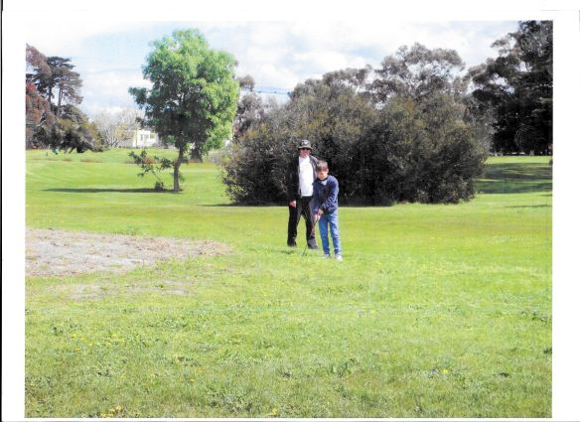
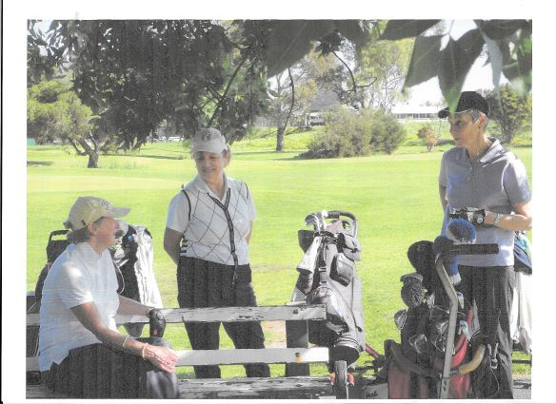
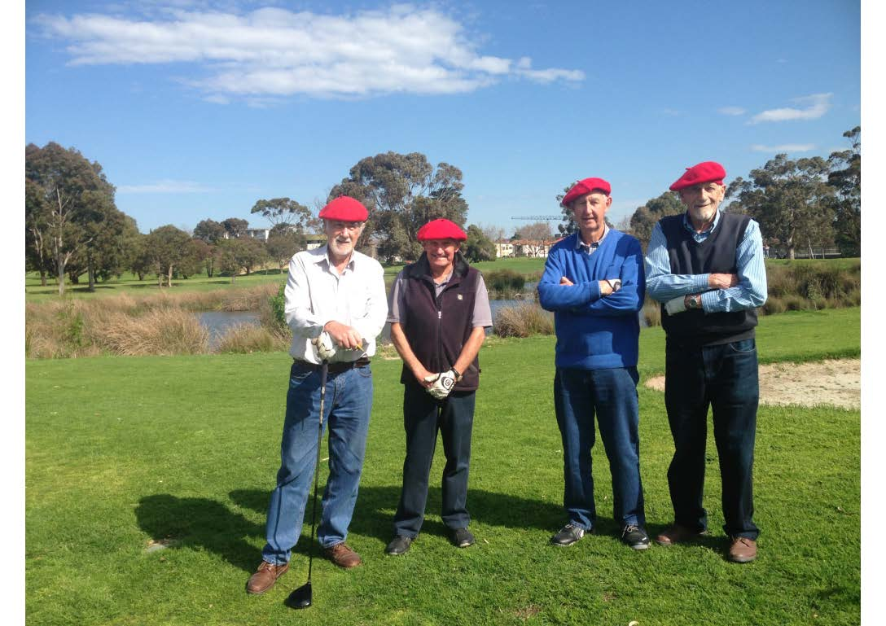

Slide 7
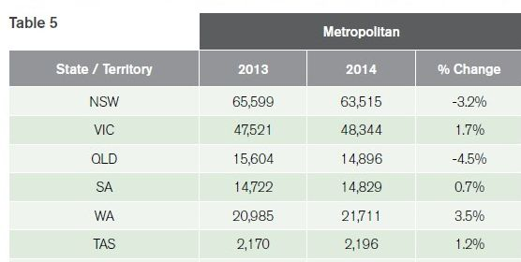
Golf:
Suits all ages – you play your own game
People with limited time can play – e.g. workers, tradesmen, young people can play 9 holes golf at Elsternwick in 1.5 hours.
Suits those who want an enjoyable walk but with a challenge!
Still affordable compared with many other activities
In Vic. the number of people playing golf is actually increasing.
2013 National Golf Participation Report
Green Acres Golf Club has 400 lady members and >1000 men.

Slide 8
Why do we need Elsternwick Park Golf Course?
Size 9 hole format suits modern life - people with limited time.
It is not too big - ideal for beginners, older people
Because it is narrow it is still interesting and challenging to good golfers.
Suitability It is suitable for beginners – is not as threatening or socially intimidating as many private courses.
Accessibility: It is a Public course providing accessible affordable recreation for casual golfers
Inexpensive for potential club members, fees in the $100s rather than $1000s
Other golf courses nearby are too busy ( Brighton Sandringham), closed (Moorabbin ) or hard to get to (Brighton, Sandringham Albert Park.

Slide 9
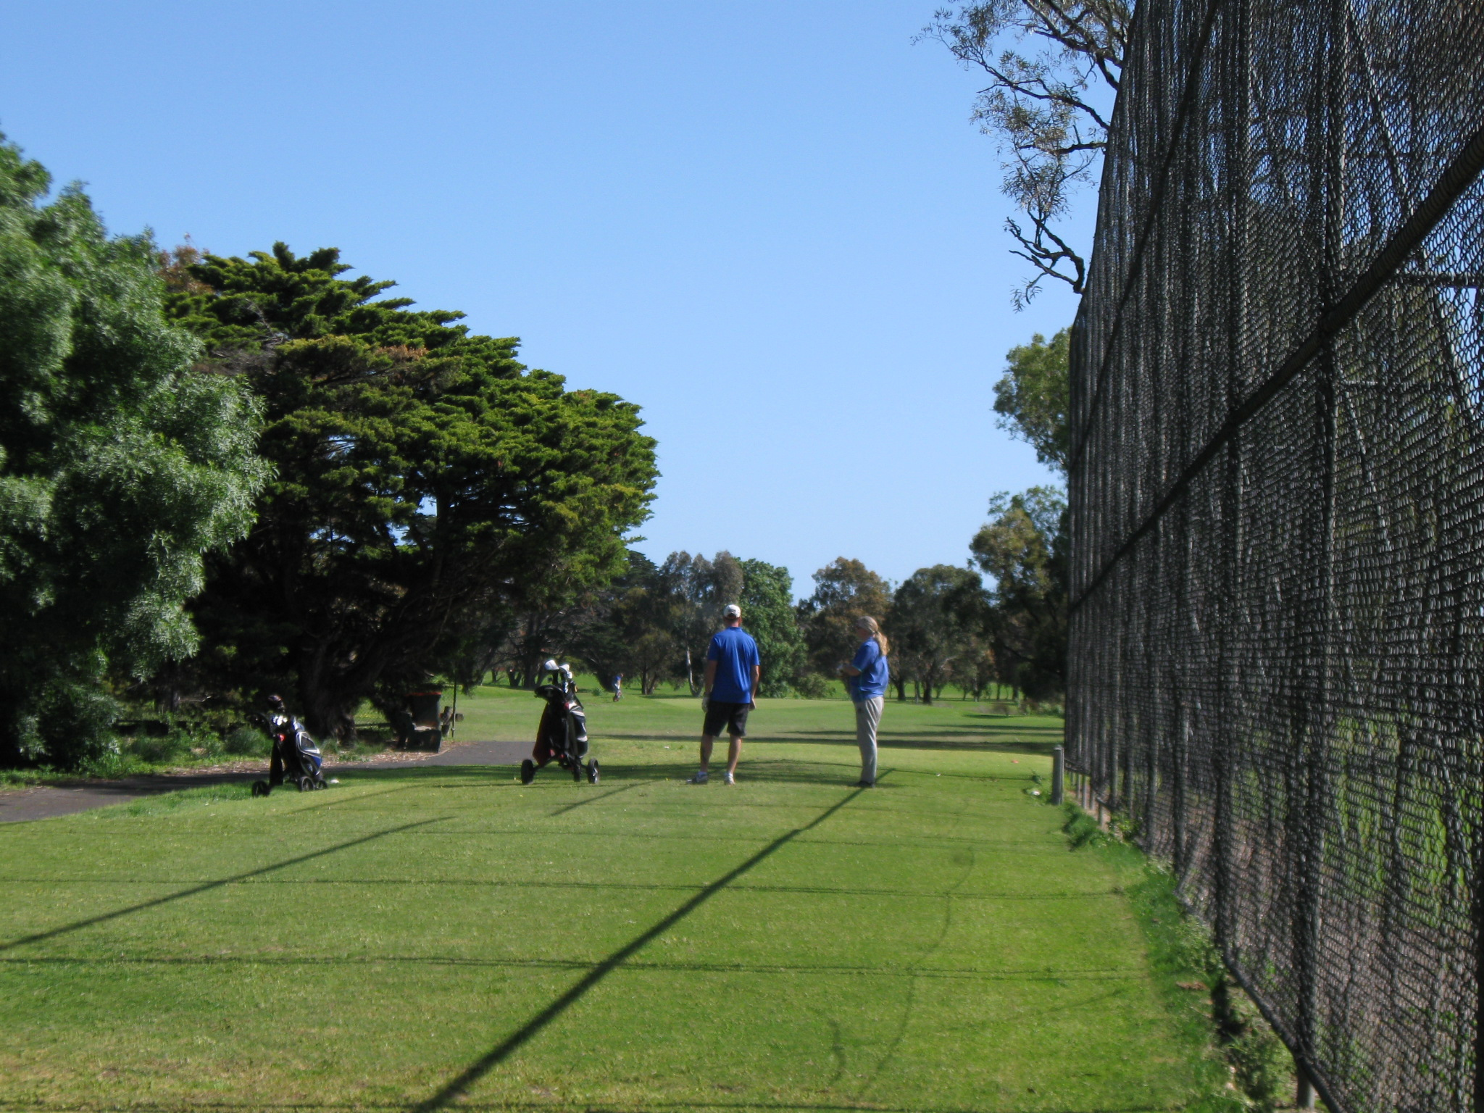

Slide 10
Looking after the Park – who and how?
Keeping it as a golf course means that –
The whole area is patrolled by a groundsman. So it is under constant surveillance.
2. Maintenance done regularly -
Grass mown and watered as required
Dead wood, fallen branches removed
Tree health is monitored
Weeds along canal cut
There is a manned facility on the site. From early in the day until late.
- if current pro-shop and car park were upgraded (better cafe, provision of Community meeting space, CCT cameras installed) this would lead to greater usage and further improve security.

Slide 11
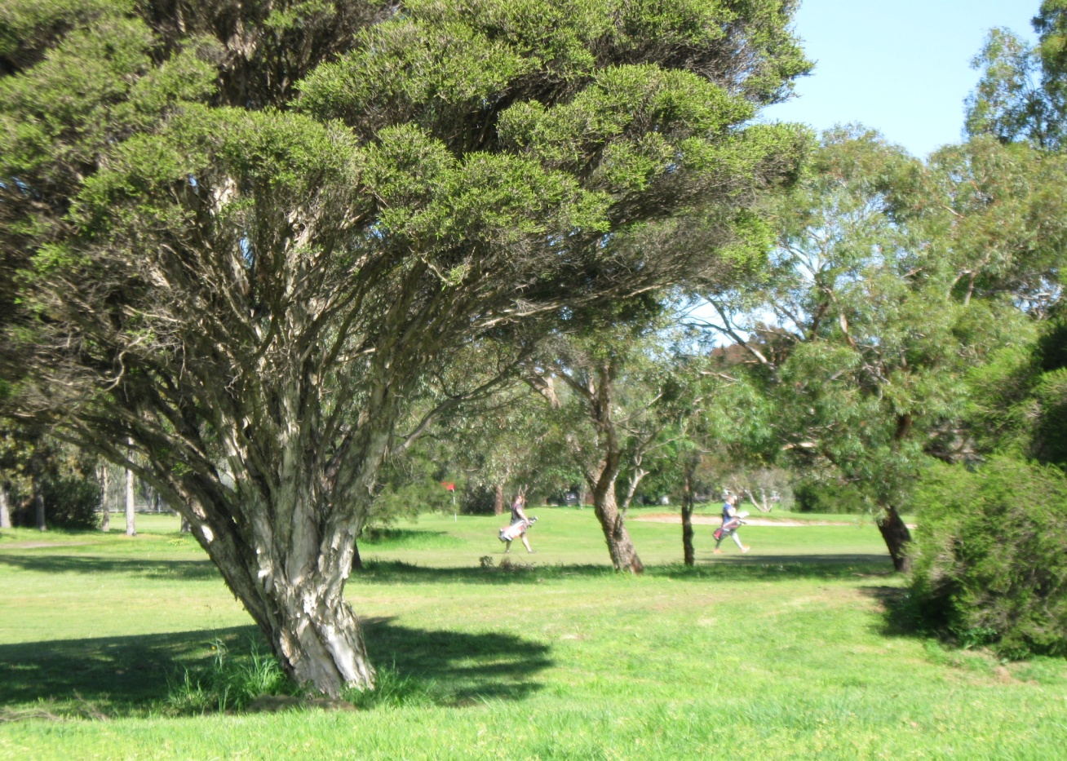
4. Golfers provide a flow of people through the Park.
Members pick up rubbish and repair divot marks
Their presence discourages undesirables.
Constant observation means problems are reported quickly
Golf ladies keep an eye on birdlife

Slide 12
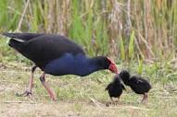
Room in the Park for everyone -
the Park should support a variety of community activities.
Golf and Eco can co-exist.
One of the nice things about playing golf is the walk amongst the beautiful old trees, birds, water and plant life.
Golfers are nature lovers and notice the new growth on the trees, the young ducklings, the Spring flowerings and the new young swamphens.
We would be delighted to see the lake area looked after better.
And an eco hut?
Larry Dunis 2008

Slide 13
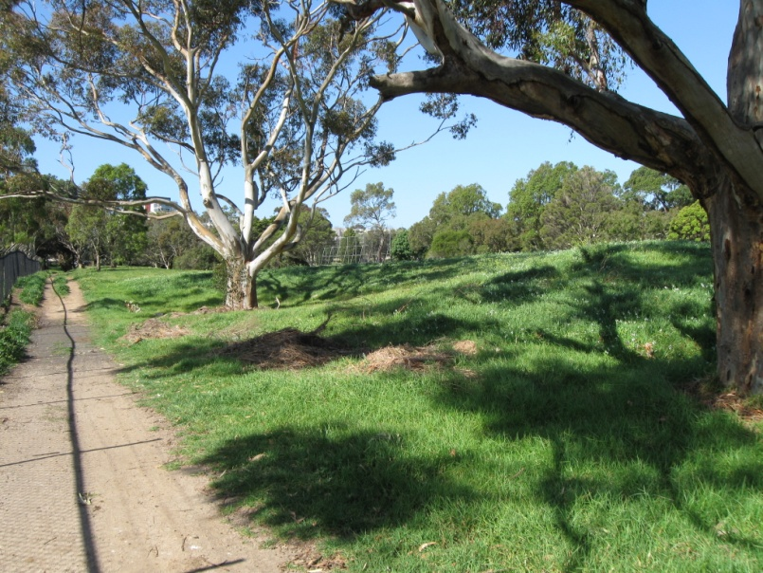
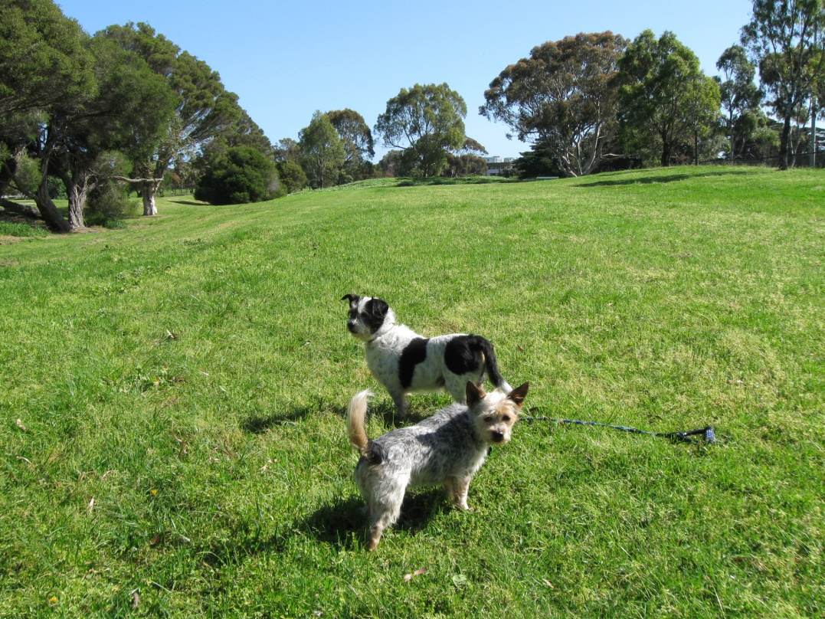
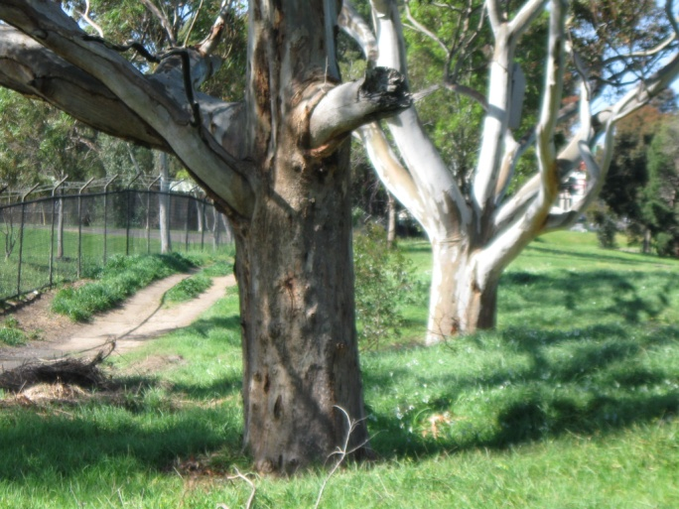
The golf course can accommodate walkers and dogs
There is presently a lovely walk available along the side of the Park where walkers and dogs can safely sniff and walk.
Maybe a community garden at the rear also?

Slide 14
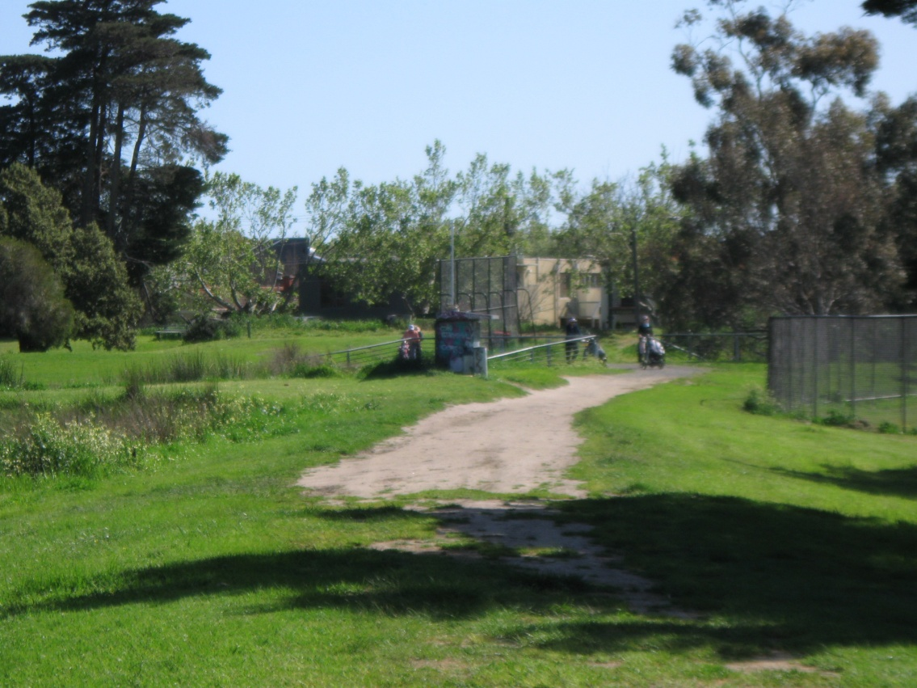
Flood Mitigation
The golf course can accommodate flood mitigation.
When flooding of the canal occurs, water can overflow onto the surrounding fairways which will recover. The impact of floods can be minimised.

Slide 15
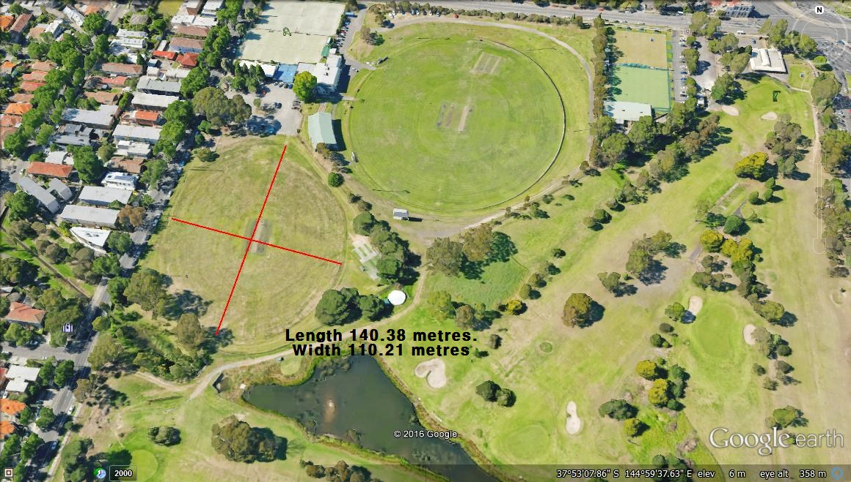
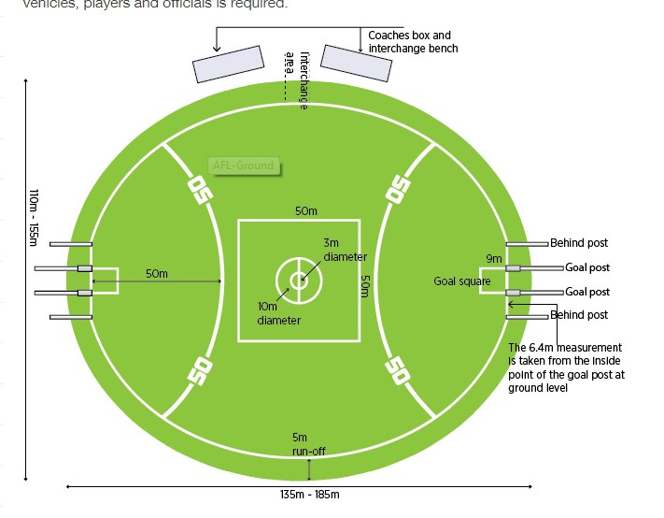
Cricket and Football
Football/Cricket needs can be met without destroying the 9 hole course
Relocation of Oval 2 is at expense of heritage trees and current golf course
Oval 2 complies with AFL allowable dimensions
Analysis of football grounds reveals many clubs have grounds no bigger than Oval 2
There are benefits to having Ovals 1 & 2 side by side

Slide 16

Table of ground sizes – thank you to Albert
11 of the 112 grounds listed as Bayside Football Ovals are same or less than Oval 2.

Slide 17
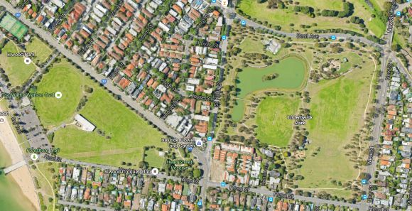

Slide 18
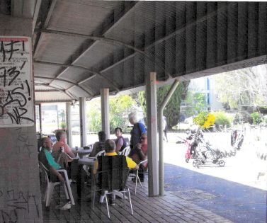
The case for keeping Elsternwick as a golf course -
Well managed 9 hole courses e.g. Cheltenham and Burnley are well patronised
Because they are shorter, 9 hole courses will continue to attract more golfers.
Beginners are able to use Elsternwick and enjoy learning there.
A well run 9 hole course maintains an income stream to support maintenance of the Park.
Established partnerships work well – Tertiary colleges use Elsternwick as a course where students can learn golf course maintenance and repair, creation of tees, planting of garden beds and grass cultivation.
Elsternwick is well placed to have golf classes which cater to school students, Sport Clubs, Seniors groups and Holiday programmes. Where will the next generation of kids learn golf easily?
Residents nearby retain their park.
And patronage would certainly increase -
If clubhouse facilities were improved and it appeared attractive to passers by. It does not invite potential golfers as it is!
Marketing of the golf course to surrounding communities and groups would also bring more players

Slide 19
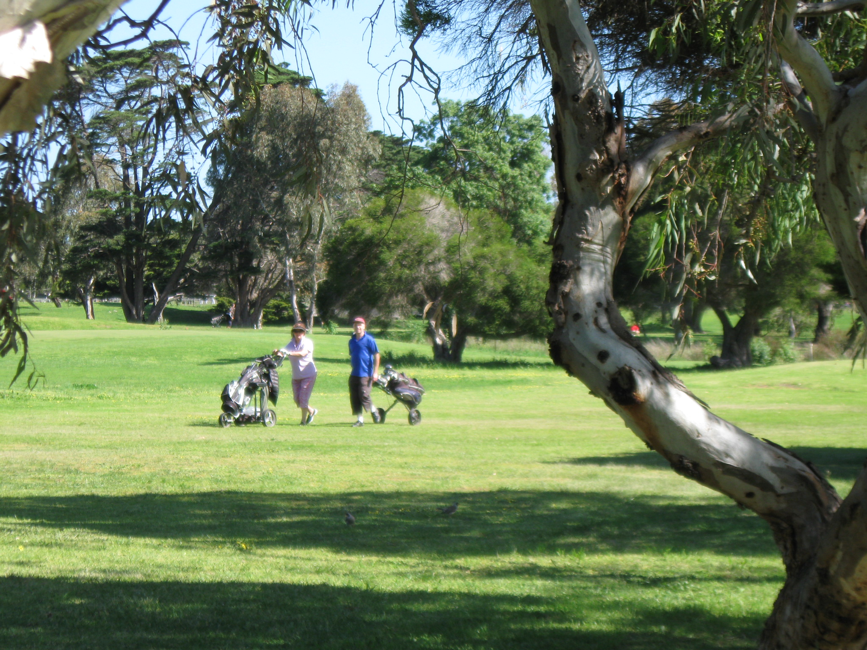

Slide 20
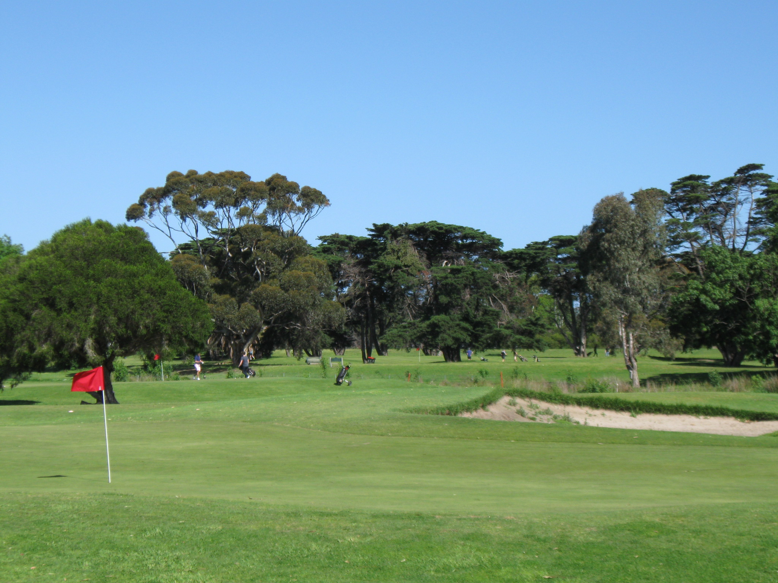

Slide 21
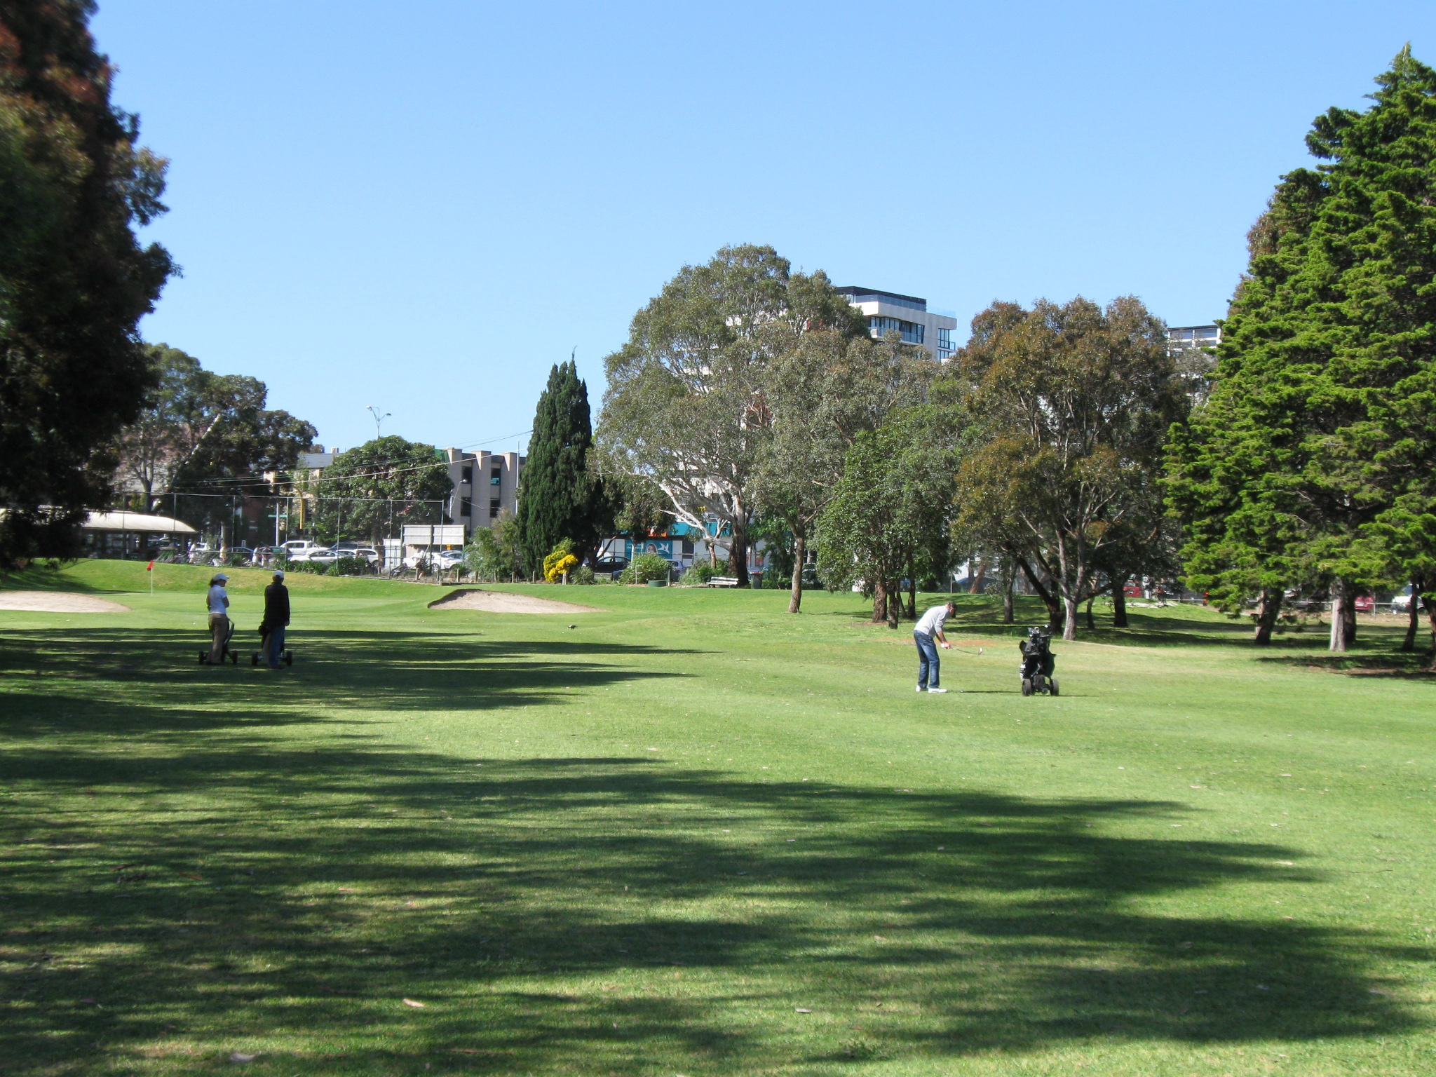

Slide 22
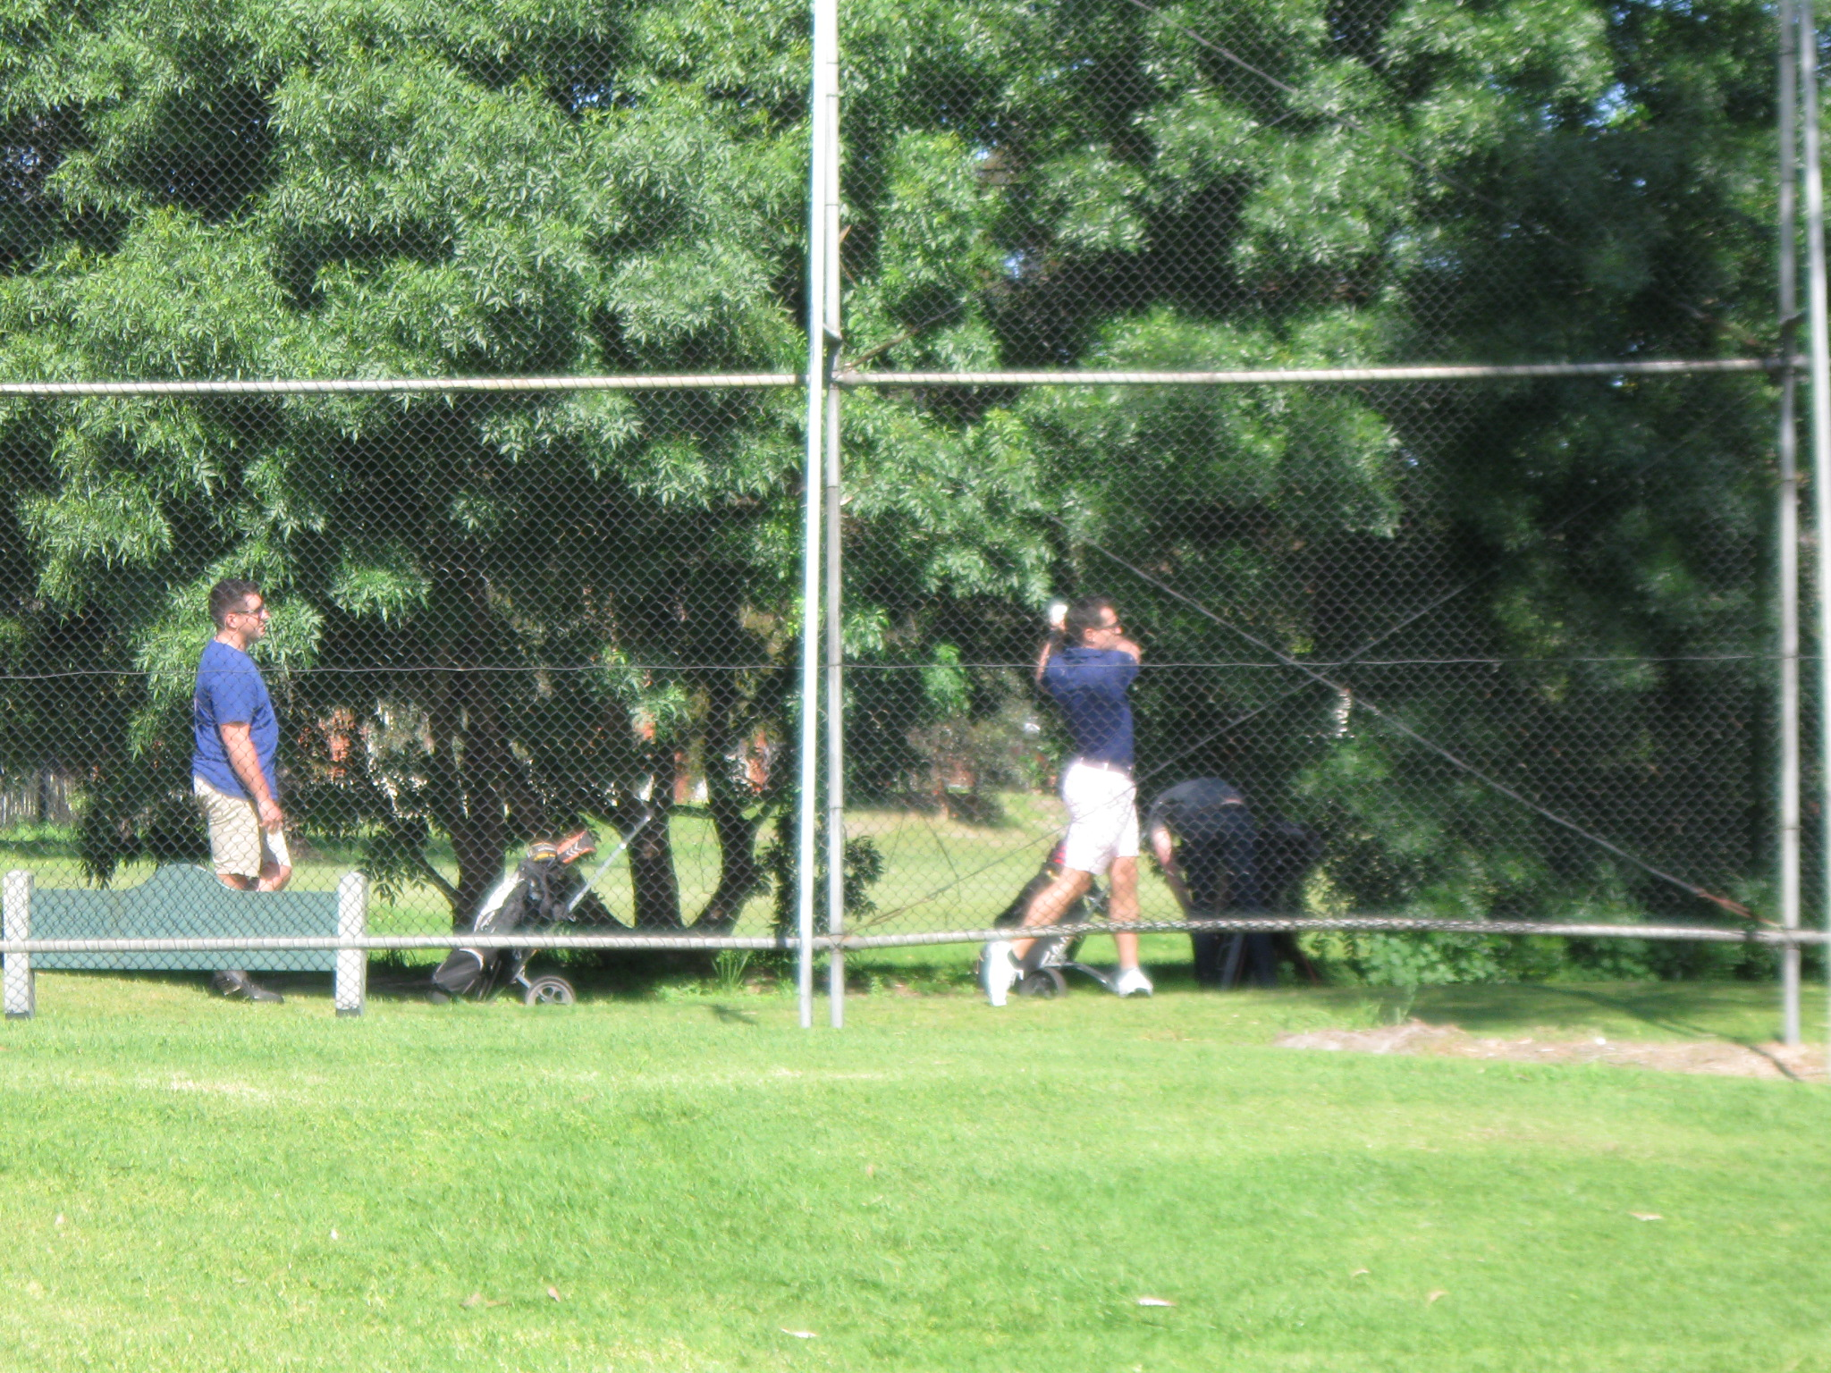

Slide 23
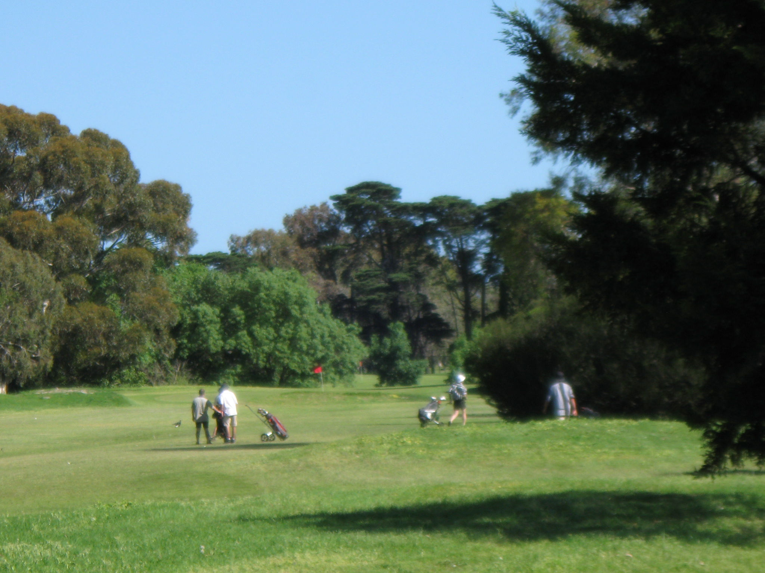

Slide 24
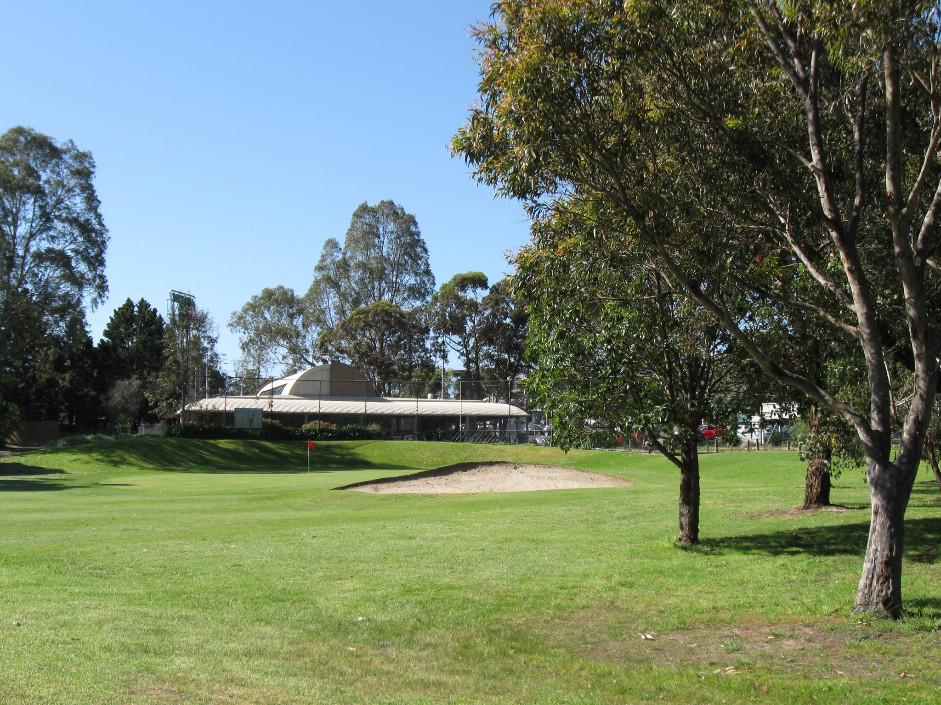
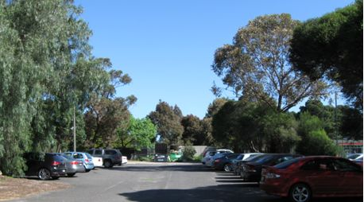

Slide 25
Quotes - from Leasing Principles for Crown Land
‘Leasing should support the development of healthy communities and, where appropriate, promote investment and encourage innovation. Decisions to lease need to consider social, economic and environmental outcomes that may result from a lease proposal.
Proposals to lease Crown land need to demonstrate the application of sustainable management principles.’
We see that a decision to keep the Park as a well run golf course would the best way to be sure that the greatest number of people have the opportunity to enjoy the Park for active recreation and leisure in a multitude of ways all day and every day of the week.

Slide 26
